Slide 1
Lab
Notebook
EECT 111-50C
Andrew bell
Fall 2015
Alcides segovia

Slide 2
Labs:
Resistor Variability Slides 4 – 8
Reading and Sorting Resistors Slides 9 – 12
Series Resistors Slides 13 – 18
Black Box Design (Series) Slides 19 – 24
Black Box Design (Parallel) Slides 25 – 30
4 Resistor Parallel Circuit Slides 31 - 35

Slide 3
Labs:
Black Box Design #3 Slides 36 - 41
Series/Parallel Resistors Slides 42 -49
Series/Parallel Capacitors Slides 50 - 54
RC Lab Slides 55 - 59
Series/Parallel Inductors Slides 60 - 66
RL Lab Slides 67 - 71

Slide 4
Lab # 01 - RESISTOR variability
Objective:
  To learn how resistors with the same color code vary.
Theory:
  The 20 - 470 Ω resistors vary between 446.5 and 493.5 Ω, (±%5)
Procedure:
  Find the color code for a 470 Ω resistor. (Y-P-Br)
  Select 20, 470 Ω
  Measure and record the resistance of each resistor in excel.
  Make a graph with the information obtained.
Tools:
  20 – 470 Ω Resistors
  Digital Multimeter: Bench 2: GDM-8245, Series: CL860264
  Excel

Slide 5
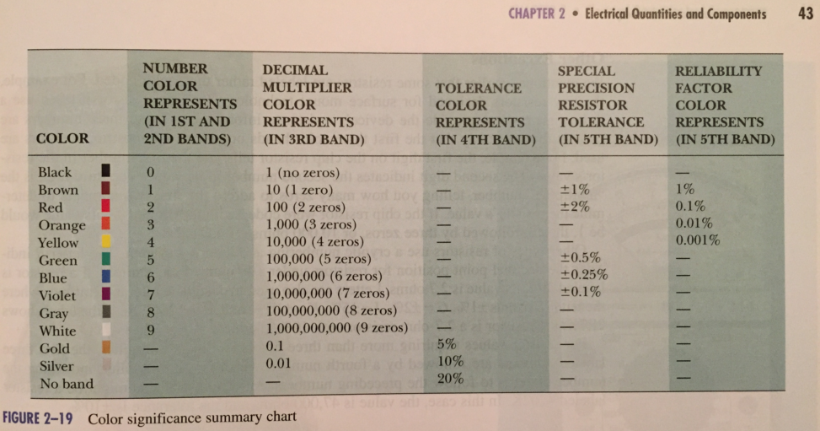
Resistor color code
Lab # 01 - RESISTOR variability
470 Ω - color code
Yellow
Violet
Brown
Gold (Tolerance) 5%

Slide 6
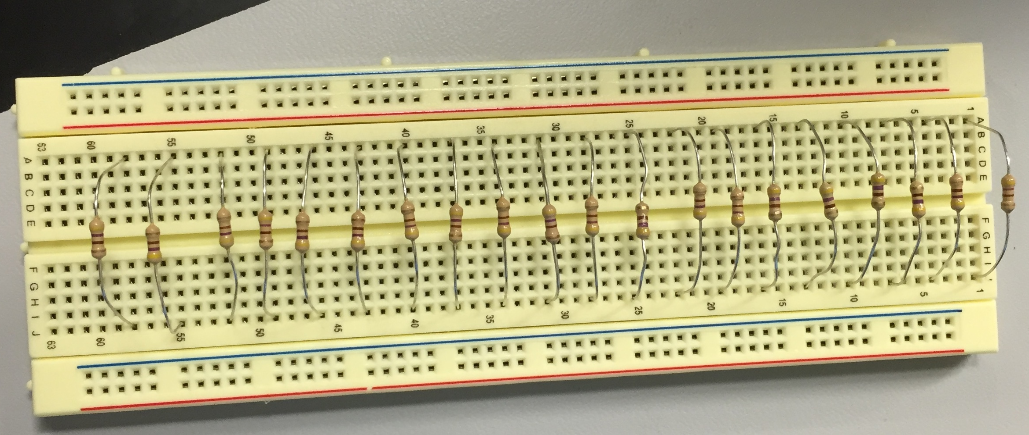
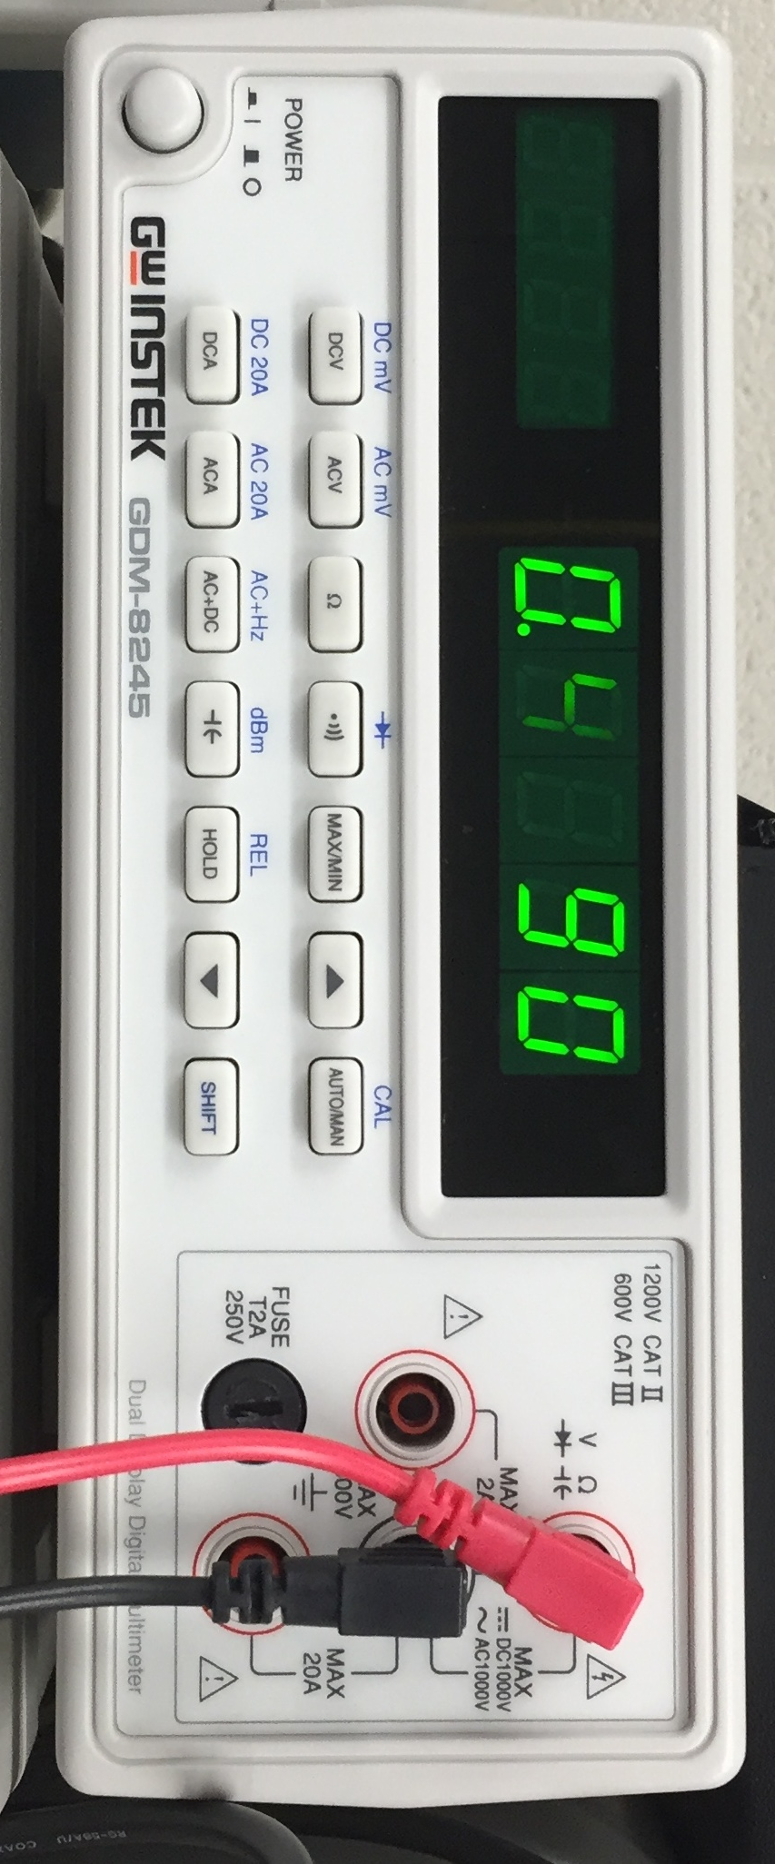
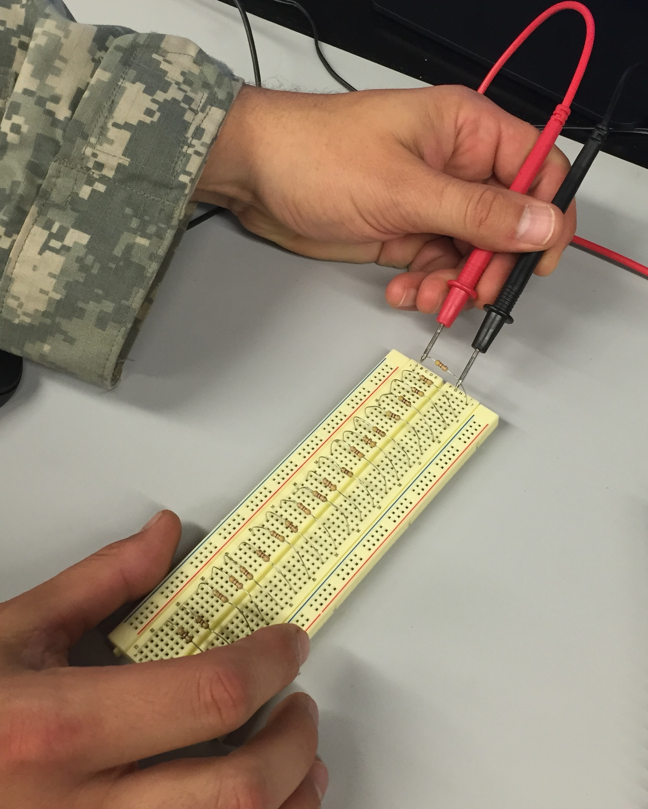
Lab # 01 - RESISTOR variability
Measuring

Slide 7
Lab # 01 - RESISTOR variability
Data
Sample | Expected | Measured Value | % Difference
1 | 470 | 459 | -0.02
2 | 470 | 456.6 | -0.03
3 | 470 | 463.8 | -0.01
4 | 470 | 463.5 | -0.01
5 | 470 | 465.6 | -0.01
6 | 470 | 462 | -0.02
7 | 470 | 465.8 | -0.01
8 | 470 | 459.7 | -0.02
9 | 470 | 463.7 | -0.01
10 | 470 | 462.4 | -0.02
11 | 470 | 472.5 | 0.01
12 | 470 | 460 | -0.02
13 | 470 | 466 | -0.01
14 | 470 | 460.7 | -0.02
15 | 470 | 456.8 | -0.03
16 | 470 | 457.7 | -0.03
17 | 470 | 463.7 | -0.01
18 | 470 | 458.5 | -0.02
19 | 470 | 460.8 | -0.02
20 | 470 | 457.4 | -0.03

Slide 8
Lab # 01 - RESISTOR variability
Conclusion/Observations
  All 20 resistors were with in tolerance (±%5 based on the 4th band – gold)
  All the legs were in good condition.
min | 456.6
max | 472.5
avg | 461.81
st dev | 3.932844

Slide 9
Lab # 02 - Reading and Sorting Resistors
Objective:
  To learn the resistor color code by sorting 15 resistors from smallest to largest value and verifying their value.
Theory:
  Each resistor should be with in it’s expected value tolerance.
Procedure:
  Using a list of the expected value of 15 resistors (from 100 Ω to 10 MΩ)
  Find the color code for each value.
  Find the resistor that matches the color code for that value.
  Measure and record the resistance of each resistor in excel.
Tools:
  15 resistors ranging from 100 Ω to 10 M Ω
  Digital Multimeter: Bench 6: GDM-8245, Series: CL860332
  Excel

Slide 10
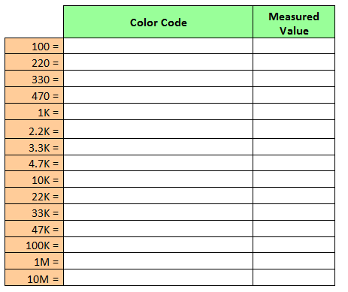
Lab # 02 - Reading and Sorting Resistors
Resistor color code
List of Resistor Values

Slide 11
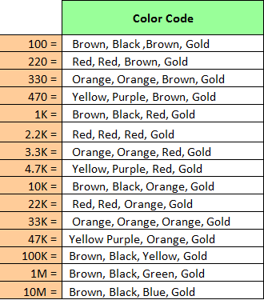
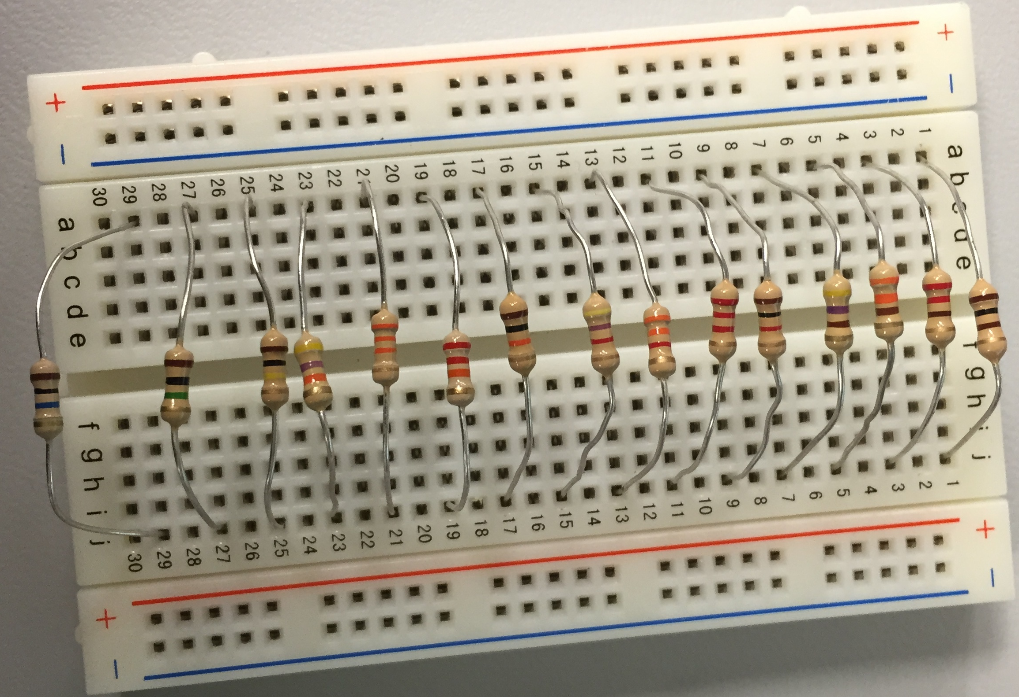
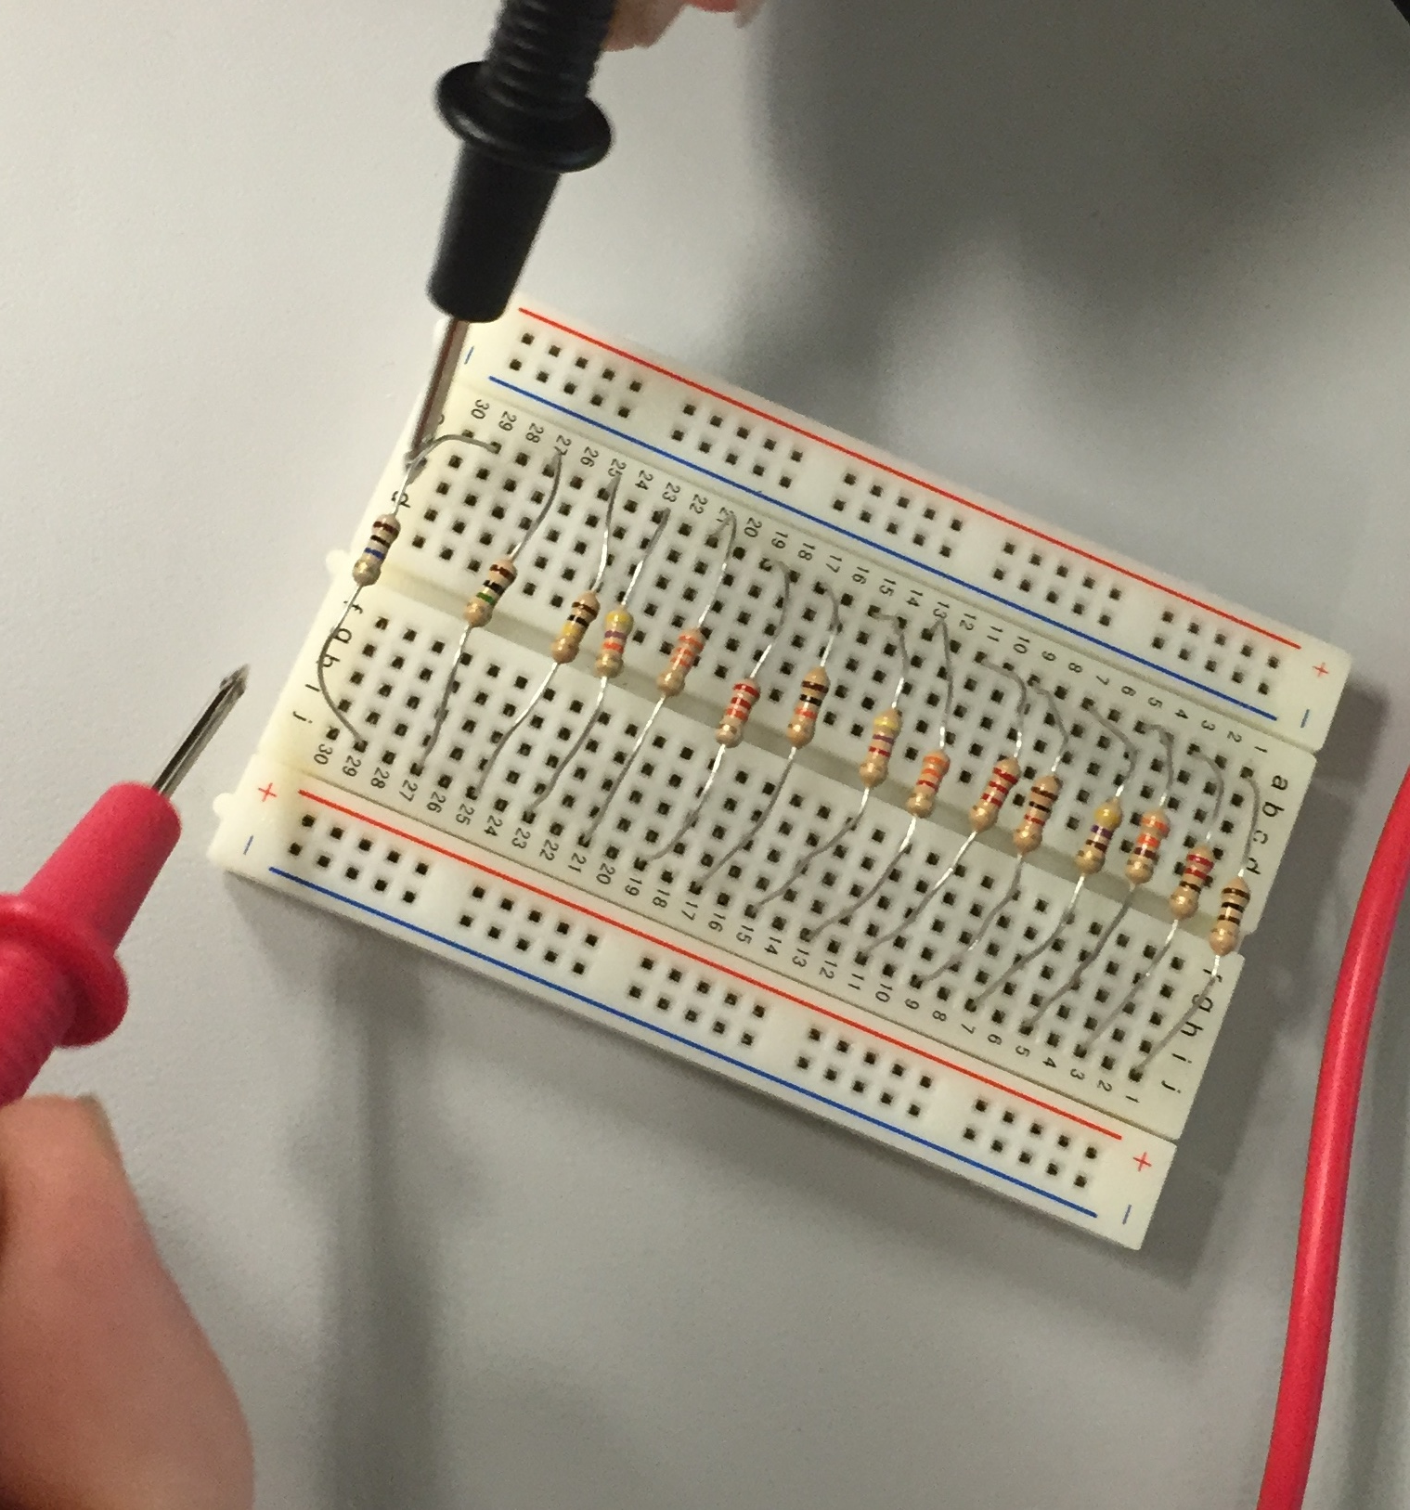
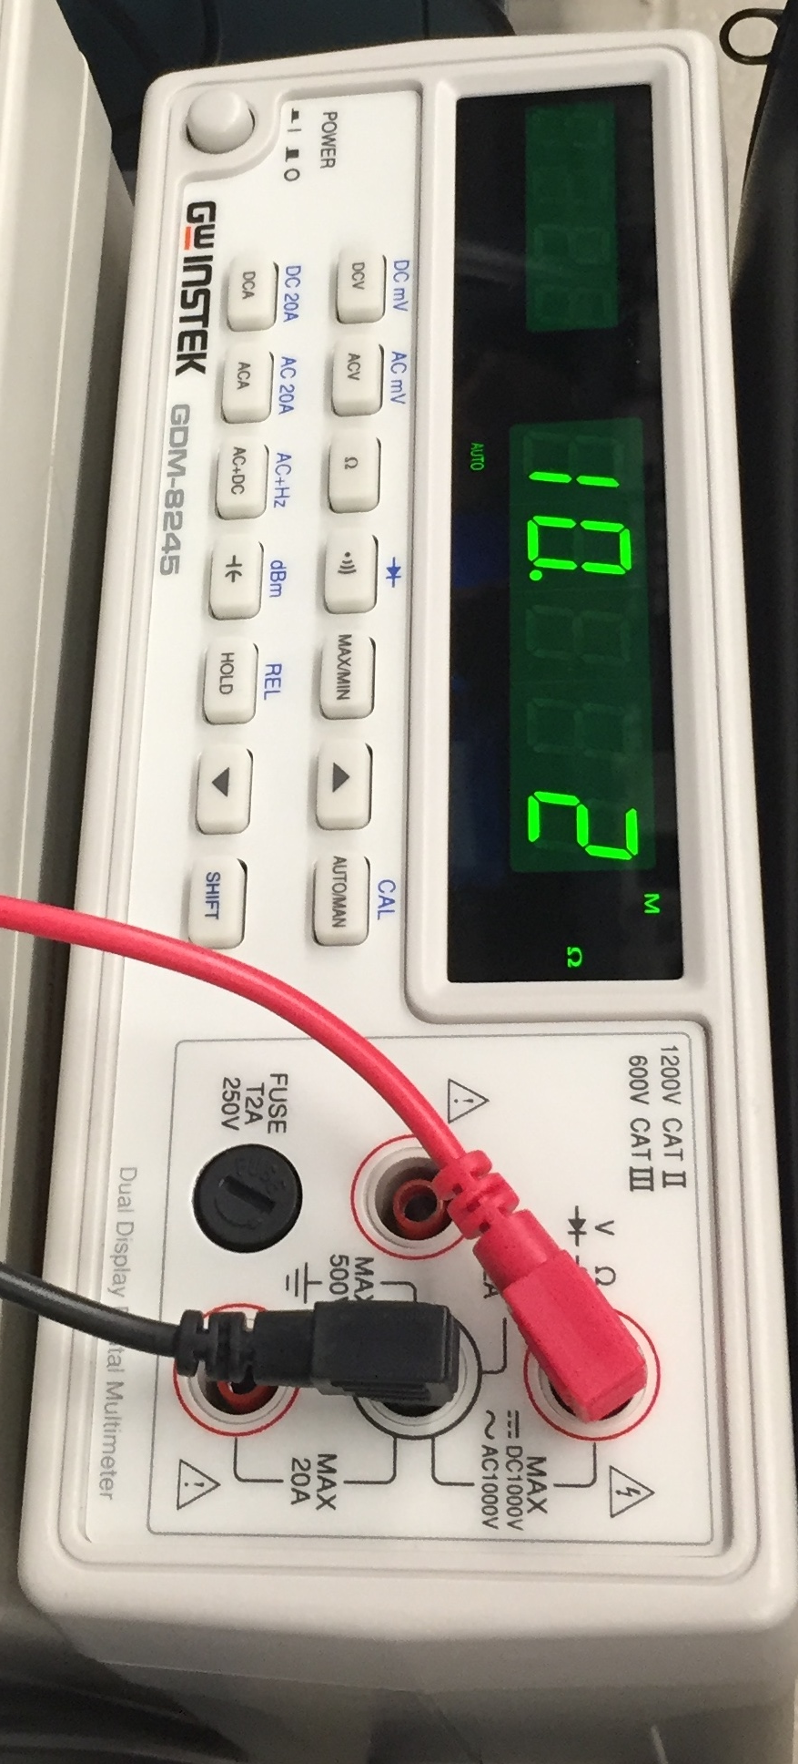
Lab # 02 - Reading and Sorting Resistors

Slide 12
Lab # 02 - Reading and Sorting Resistors
Conclusion/Observations
  Kit #6 – was missing a 22 kΩ resistor and had an extra 2.2 kΩ resistor.
  All 15 resistors were with in tolerance (±%5 based on the 4th band – gold)
  All the legs were in good condition.
Resistance Value | Measured Value | Percent Difference
100 | 98.31 | -1.69%
220 | 216.7 | -1.50%
330 | 324.7 | -1.61%
470 | 465.2 | -1.02%
1 | 0.9782 | -2.18%
2.2 | 2.153 | -2.14%
3.3 | 3.248 | -1.58%
4.7 | 4.577 | -2.62%
10 | 9.772 | -2.28%
22 | 21.507 | -2.24%
33 | 33.054 | 0.16%
47 | 46.923 | -0.16%
100 | 99.65 | -0.35%
1 | 0.9976 | -0.24%
10 | 10.28 | 2.80%

Slide 13
Lab # 03 - Series Resistors
Objective:
  To experiment with series circuit and verify that the simulation, analysis and test results all agree.
Theory:
  The simulation in multisim, analysis through calculation and test by measuring all have the same outcome.
Tools:
  3 resistors (10 kΩ, 2.2 KΩ and 4.7 kΩ)
  Digital Multimeter: Bench 6: GDM-8245, Series: CL860332
  Excel
  Multisim

Slide 14
Lab # 03 - Series Resistors
Procedure:
  Simulate:
    Build the circuit in the figure 1 and then figure 2 in multisim (Both on next slide)
  Calculate:
    Calculate the total resistance of a series circuit with 3 resistors (10K, 2.2K and 4.7K)
    Calculate the currents VA, VB and VT
  Measure:
    Measure and record the resistance of each resistor in excel.
    Connect the resistors as shown in the figure1.
    Measure and record the total resistance (RT)
    Connect the resistors as shown in the figure 2 with 9V
    Measure and record the current (IT) and voltage (V1, VA and VB) of the series circuit

Slide 15
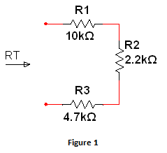
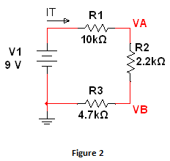
Lab # 03 - Series Resistors
 | 3 BAND COLOR CODE
10kΩ | Brown | Black | Orange
2.2kΩ | Red | Red | Red
4.7kΩ | Yellow | Violet | Red

Slide 16
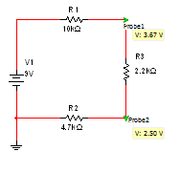
Lab # 03 - Series Resistors
Multisim
Excel
 | Measured | Calculated | Simulated
R1 = | 9774 | 10000 | 10000
R2 = | 2161 | 2200 | 2200
R3 = | 4.6E+3 | 4700 | 4700
RT = | 16551 | 16900 | 16900
 | Measured | Calculated | Simulated
IT = | 540.7E-6 | 532.5E-6 | 532.5E-6
VT= | 8.949 | 9 | 9
V1 = | 8.949 | 9 | 9
VA = | 3.663 | 3.7E+0 | 3.67
VB = | 2.495 | 2.5E+0 | 2.5
RT = R1 + R2 + R3
IT = VT / RT
Vin = IT * RT
VA = IT * (R2+R3)
VB = IT * R3

Slide 17
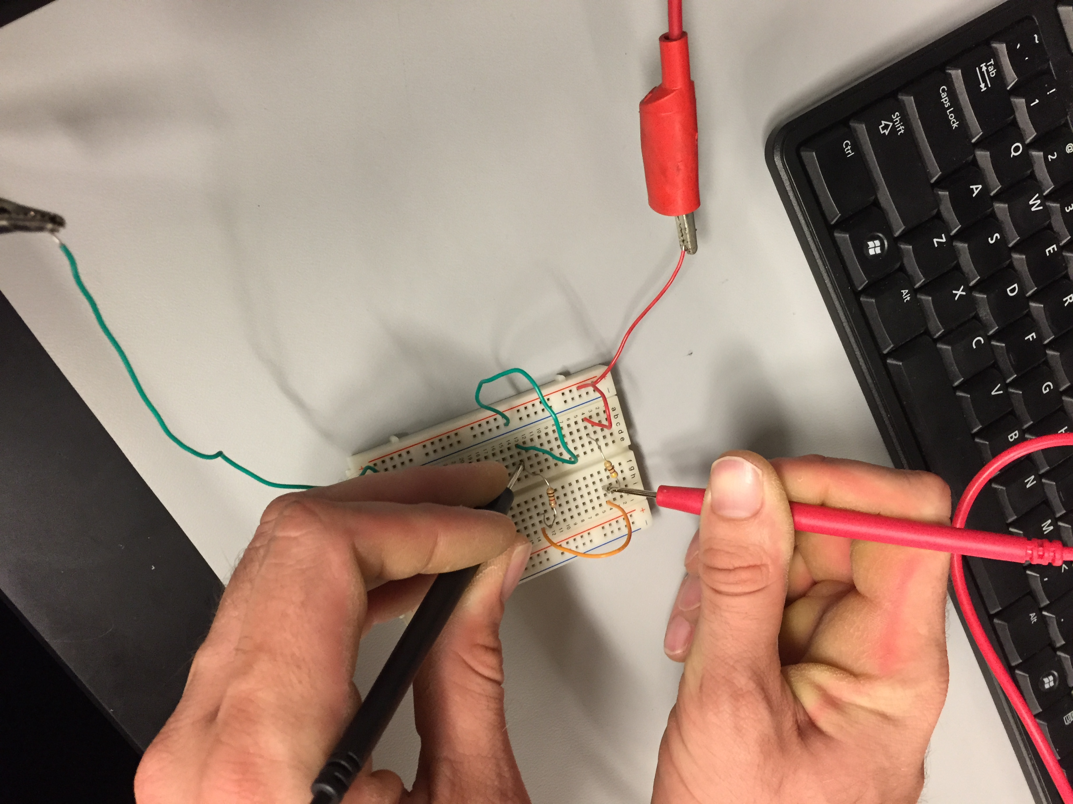
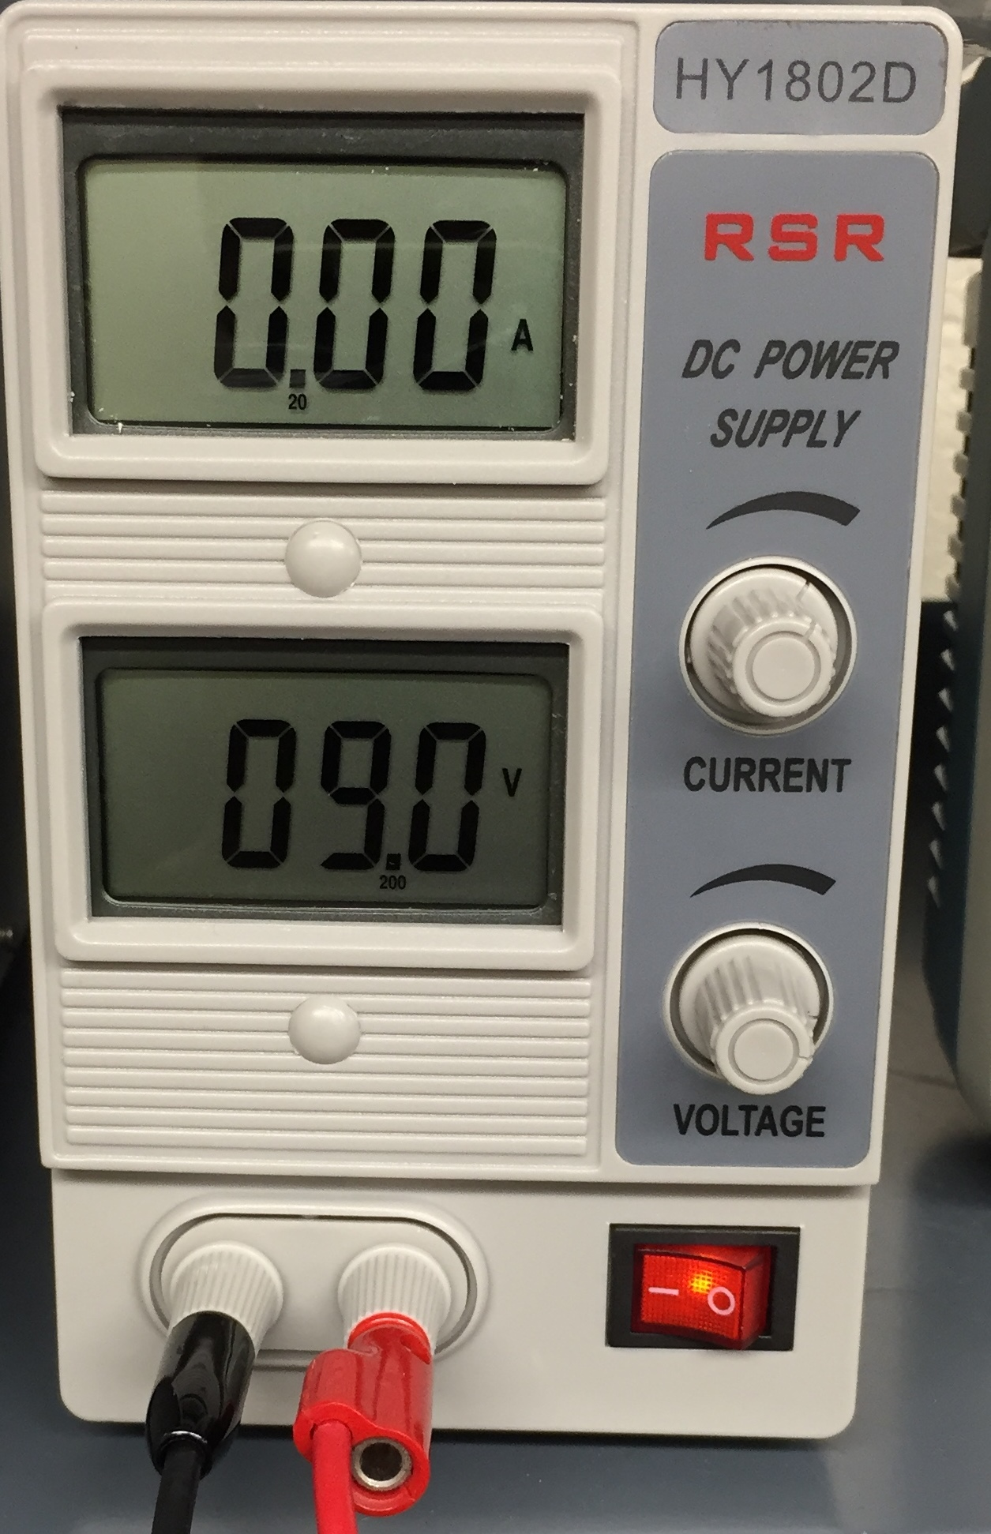
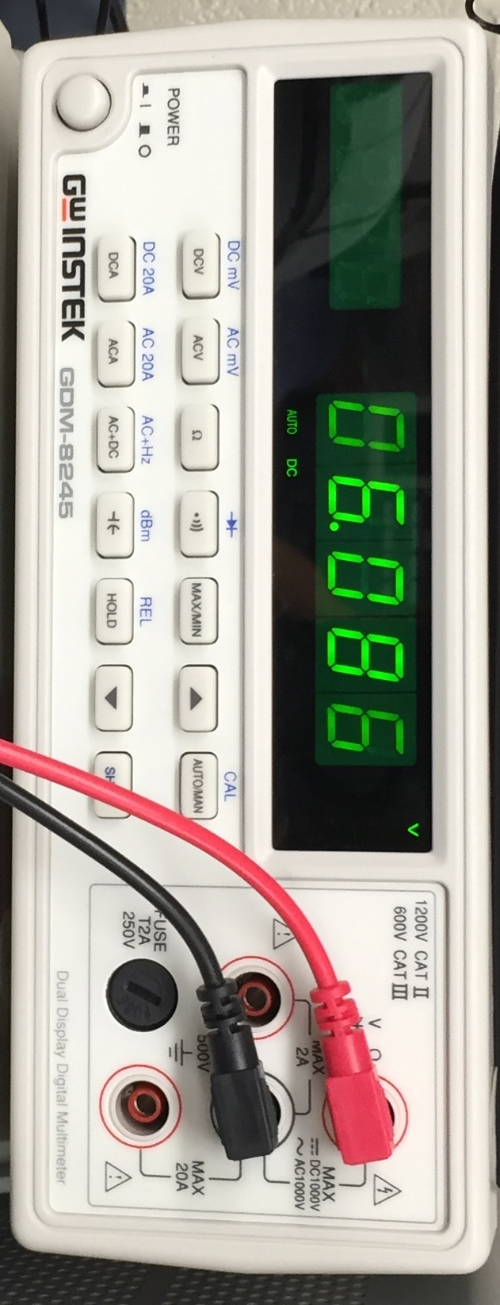
Lab # 03 - Series Resistors
Measuring

Slide 18
Lab # 03 - Series Resistors
Measuring
Conclusion/Observations
  The simulation in multisim and analysis through calculation had the same outcome, while test by measuring was a little off it was still with in the parameters.
  The resistors measured value were within the ±5%

Slide 19
Lab # 04 – Black Box Design (Series)
Objective:
  Design a 3 resistor series circuit that meets the voltage and current requirements using “standard” resistor values.
Theory:
  Using “standard” resistors and 9V applied will draw a current of 10mA.
Tools:
  3 resistors (100 Ω, 330 Ω and 470 Ω)
  Digital Multimeter: Bench 6: GDM-8245, Series: CL860332
  Excel
  Multisim

Slide 20
Lab # 04 – Black Box Design (Series)
Procedure:
  Calculate:
    Find the total resistance by dividing voltage by currents. RT = 900 Ω
    Find the combination of 3 resistors that gives you an RT of 900 Ω
      100 Ω + 330 Ω + 470 Ω = 900 Ω
  Simulate:
    Build a series circuit using the 3 resistors combination:
      Measure the total resistance (RT).
      Measure the total current (IT).
  Measure:
    Find the resistors by their color code. (100Ω - Br-Bl-Br, 330Ω - O-O-Br, 470Ω - Y-V-Br)
    Measure and record the resistance of each resistor in excel.
    Connect the resistors in series.
    Measure and record the total resistance (RT)
    Add 9V to the circuit
    Measure and record the current (IT)
    Make a graph

Slide 21
Lab # 04 – Black Box Design (Series)
In Preparation for this lab:
Created a standard resistor combination chart in excel.
 | 3 Resistors
 | A | B | C | D | E
 | 100 | 220 | 330 | 470 | 1000
A + A + | 300 | 420 | 530 | 670 | 1200
A + B + | 420 | 540 | 650 | 790 | 1320
A + C + | 530 | 650 | 760 | 900 | 1430
A + D + | 670 | 790 | 900 | 1040 | 1570
A + E + | 1200 | 1320 | 1430 | 1570 | 2100
 | A | B | C | D | E
 | 100 | 220 | 330 | 470 | 1000
B + A + | 420 | 540 | 650 | 790 | 1320
B + B + | 540 | 660 | 770 | 910 | 1440
B + C + | 650 | 770 | 880 | 1020 | 1550
B + D + | 790 | 910 | 1020 | 1160 | 1690
B + E + | 1320 | 1440 | 1550 | 1690 | 2220
 | A | B | C | D | E
 | 100 | 220 | 330 | 470 | 1000
C + A + | 530 | 650 | 760 | 900 | 1430
C + B + | 650 | 770 | 880 | 1020 | 1550
C + C + | 760 | 880 | 990 | 1130 | 1660
C + D + | 900 | 1020 | 1130 | 1270 | 1800
C + E + | 1430 | 1550 | 1660 | 1800 | 2330
 | A | B | C | D | E
 | 100 | 220 | 330 | 470 | 1000
D + A + | 670 | 790 | 900 | 1040 | 1570
D + B + | 790 | 910 | 1020 | 1160 | 1690
D + C + | 900 | 1020 | 1130 | 1270 | 1800
D + D + | 1040 | 1160 | 1270 | 1410 | 1940
D + E + | 1570 | 1690 | 1800 | 1940 | 2470
 | A | B | C | D | E
 | 100 | 220 | 330 | 470 | 1000
E + A + | 1200 | 1320 | 1430 | 1570 | 2100
E + B + | 1320 | 1440 | 1550 | 1690 | 2220
E + C + | 1430 | 1550 | 1660 | 1800 | 2330
E + D + | 1570 | 1690 | 1800 | 1940 | 2470
E + E + | 2100 | 2220 | 2330 | 2470 | 3000
 | 1 Resistor
 | A | B | C | D | E
 | 100 | 220 | 330 | 470 | 1000
 | 2 Resistors
 | A | B | C | D | E
 | 100 | 220 | 330 | 470 | 1000
A + | 200 | 320 | 430 | 570 | 1100
B + | 320 | 440 | 550 | 690 | 1220
C + | 430 | 550 | 660 | 800 | 1330
D + | 570 | 690 | 800 | 940 | 1470
E + | 1100 | 1220 | 1330 | 1470 | 2000

Slide 22
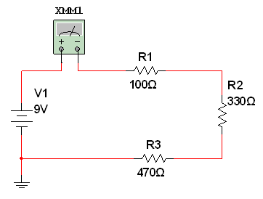
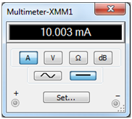
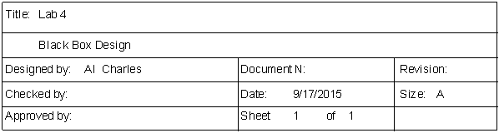
Lab # 04 – Black Box Design (Series)
Data
Multisim
Based on the resistor combination chart, these are the resistor needed for a RT of 900Ω:
1 - 100Ω
2 - 330Ω
3 - 470Ω
 | Design | Measured | Calculated | Simulated | Units
V1 = | 9 | 9.009 | 9 | 9 | V
IT = | 10.0E-3 | 10.1E-3 | 10.0E-3 | 10.0E-3 | A
RT = | 900 | 882.7 | 900 | 899.73 | Ω
R1 = | 100 | 98.75 | 100 | 100 | Ω
R2 = | 330 | 324.1 | 330 | 330 | Ω
R3 = | 470 | 459.5 | 470 | 470 | Ω

Slide 23
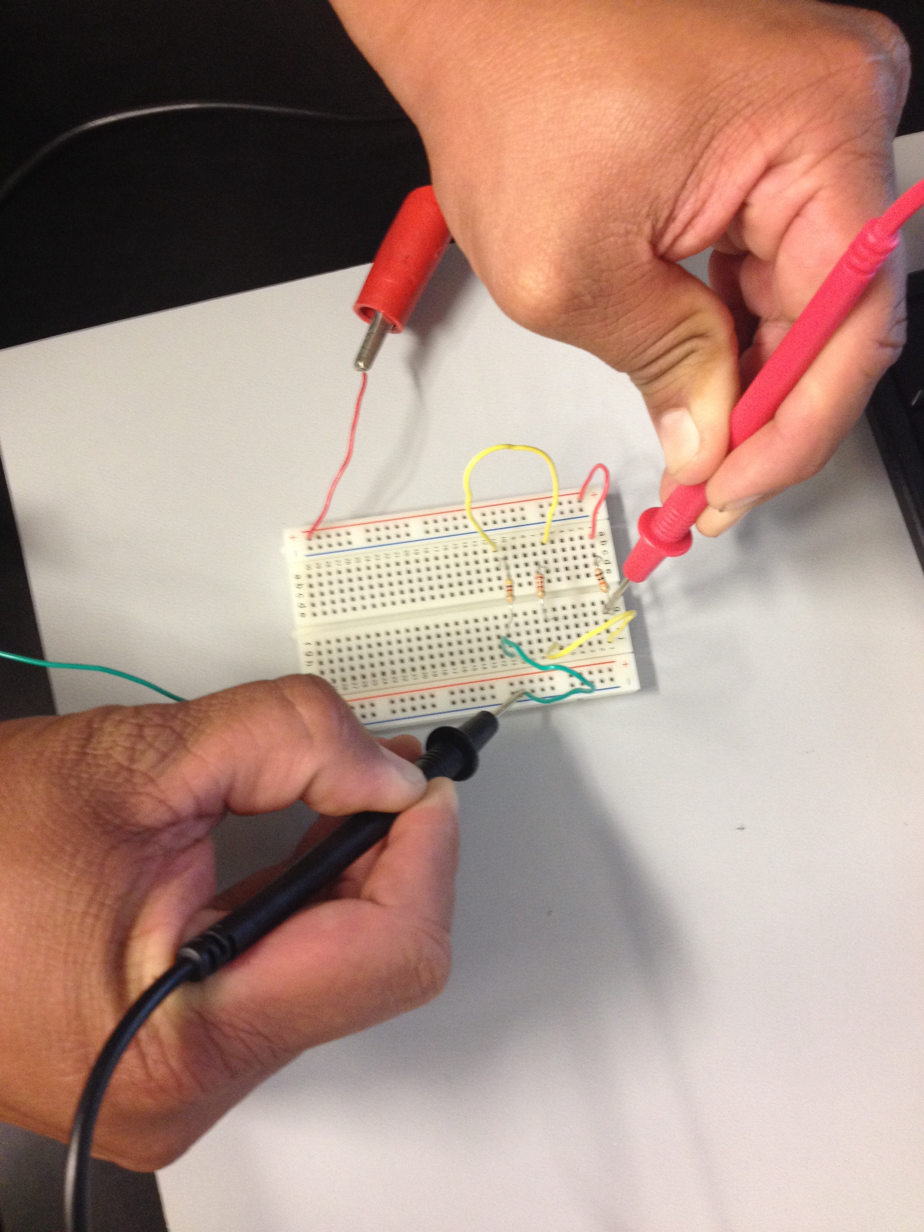
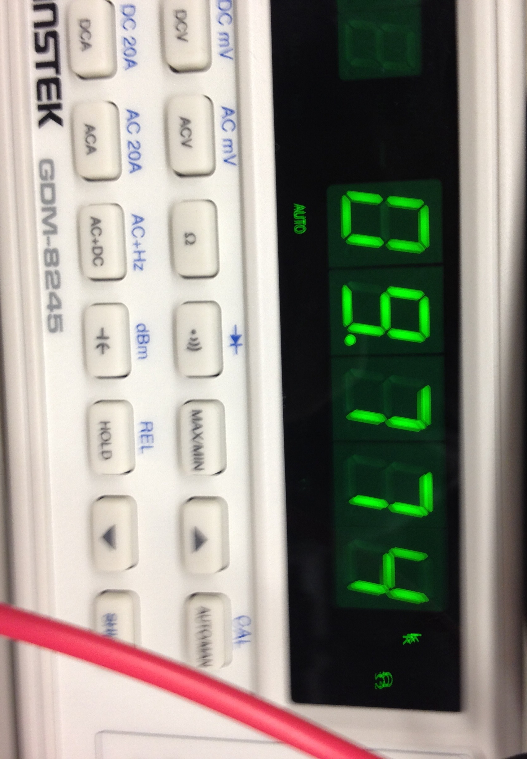
Lab # 04 – Black Box Design (Series)
Measuring Total Resistance

Slide 24
Lab # 04 – Black Box Design (Series)
Excel Data
 | Resistance | Current
0.1 | 90.0E+0 | 100.0E-3
0.136 | 122.4E+0 | 73.5E-3
0.172 | 154.8E+0 | 58.1E-3
0.208 | 187.2E+0 | 48.1E-3
0.244 | 219.6E+0 | 41.0E-3
0.28 | 252.0E+0 | 35.7E-3
0.316 | 284.4E+0 | 31.6E-3
0.352 | 316.8E+0 | 28.4E-3
0.388 | 349.2E+0 | 25.8E-3
0.424 | 381.6E+0 | 23.6E-3
0.46 | 414.0E+0 | 21.7E-3
0.496 | 446.4E+0 | 20.2E-3
0.532 | 478.8E+0 | 18.8E-3
0.568 | 511.2E+0 | 17.6E-3
0.604 | 543.6E+0 | 16.6E-3
0.64 | 576.0E+0 | 15.6E-3
0.676 | 608.4E+0 | 14.8E-3
0.712 | 640.8E+0 | 14.0E-3
0.748 | 673.2E+0 | 13.4E-3
0.784 | 705.6E+0 | 12.8E-3
0.82 | 738.0E+0 | 12.2E-3
0.856 | 770.4E+0 | 11.7E-3
0.892 | 802.8E+0 | 11.2E-3
0.928 | 835.2E+0 | 10.8E-3
0.964 | 867.6E+0 | 10.4E-3
1 | 900.0E+0 | 10.0E-3
1.36 | 1.2E+3 | 7.4E-3
1.72 | 1.5E+3 | 5.8E-3
2.08 | 1.9E+3 | 4.8E-3
2.44 | 2.2E+3 | 4.1E-3
2.8 | 2.5E+3 | 3.6E-3
3.16 | 2.8E+3 | 3.2E-3
3.52 | 3.2E+3 | 2.8E-3
3.88 | 3.5E+3 | 2.6E-3
4.24 | 3.8E+3 | 2.4E-3
4.6 | 4.1E+3 | 2.2E-3
4.96 | 4.5E+3 | 2.0E-3
5.32 | 4.8E+3 | 1.9E-3
5.68 | 5.1E+3 | 1.8E-3
6.04 | 5.4E+3 | 1.7E-3
6.4 | 5.8E+3 | 1.6E-3
6.76 | 6.1E+3 | 1.5E-3
7.12 | 6.4E+3 | 1.4E-3
7.48 | 6.7E+3 | 1.3E-3
7.84 | 7.1E+3 | 1.3E-3
8.2 | 7.4E+3 | 1.2E-3
8.56 | 7.7E+3 | 1.2E-3
8.92 | 8.0E+3 | 1.1E-3
9.28 | 8.4E+3 | 1.1E-3
9.64 | 8.7E+3 | 1.0E-3
10 | 9.0E+3 | 1.0E-3
Graph

Slide 25
Lab # 06 – Black Box Design
Series and Parallel
Objective:
  Learn about series/parallel circuits. Design a 2 resistor series circuit that meets the voltage and current requirements using “standard” resistor value.
Theory:
  Using 2 “standard” resistors in series and 9V applied will draw a current of 18mA.
Tools:
  2 resistors (220 Ω, and 330 Ω)
  Digital Multimeter: Bench 6: GDM-8245, Series: CL860332
  Excel
  Multisim

Slide 26
Lab # 06 – Black Box Design #3
Procedure:
  Calculate:
    Find the total resistance by dividing voltage by currents. RT = 9V/18mA = 500 Ω
    Find the combination of 2 resistors in series that gives you an RT of 500 Ω or closest:
      220 Ω + 330 Ω = 550 Ω
  Simulate:
    Build a series circuit in multisim of using the 2 resistor combination.
      Measure the total resistance (RT)
      Measure the total current (IT)
    Build a parallel circuit in multisim of using the same 2 resistor combination
      Measure the total resistance (RT)
      Measure the total current (IT)
  Measure:
    Series:
      Find the resistors by their color code. (220 Ω - R-R-Br and 330 Ω - O-O-Br)
      Measure and record the resistance of each resistor in excel.
      Connect the resistors in series.
      Measure and record the total resistance (RT) in series
      Add 9V to the circuit.
      Measure and record the current (IT)
    Parallel:
      Connect the resistors in parallel
      Measure and record the total resistance (RT) in parallel
      Add 9V to the circuit
      Measure and record the I1, I2 and IT

Slide 27
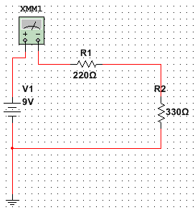
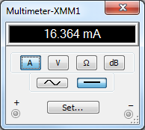
Lab # 06 – Black Box Design #3
Series Circuit
Data Recorded in Excel
Simulation in Multisim
 | Design | Measured | Calculated | Simulated | Units
V1 = | 9 | 9 | 9 | 9 | V
IT = | 16.3E-3 | 16.7E-3 | 16.4E-3 | 16.3E-3 | Amps
RT = | 550 | 540.5 | 550 | 550 | Ω
R1 = | 220 | 217.8 | 220 | 220 | Ω
R2 = | 330 | 322.5 | 330 | 330 | Ω

Slide 28
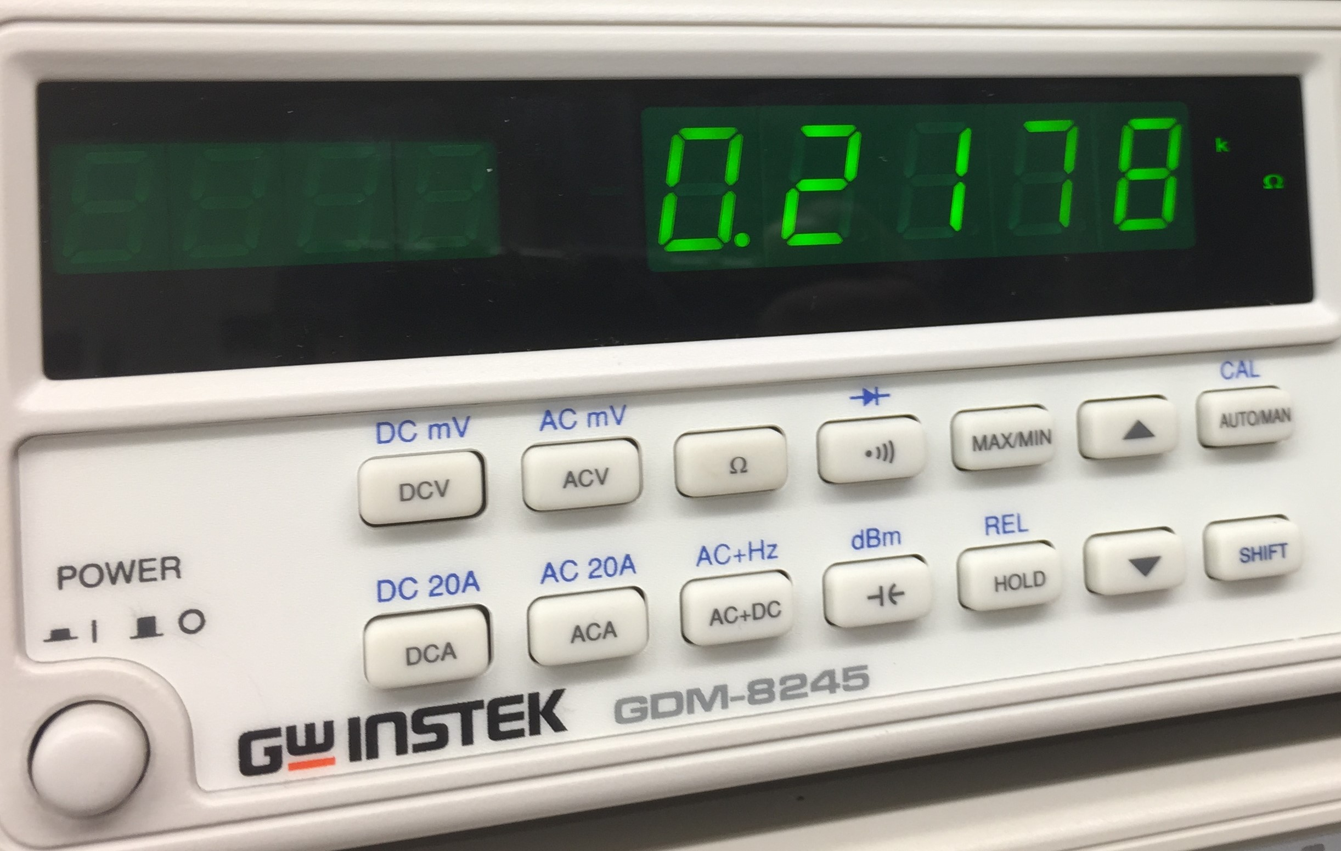
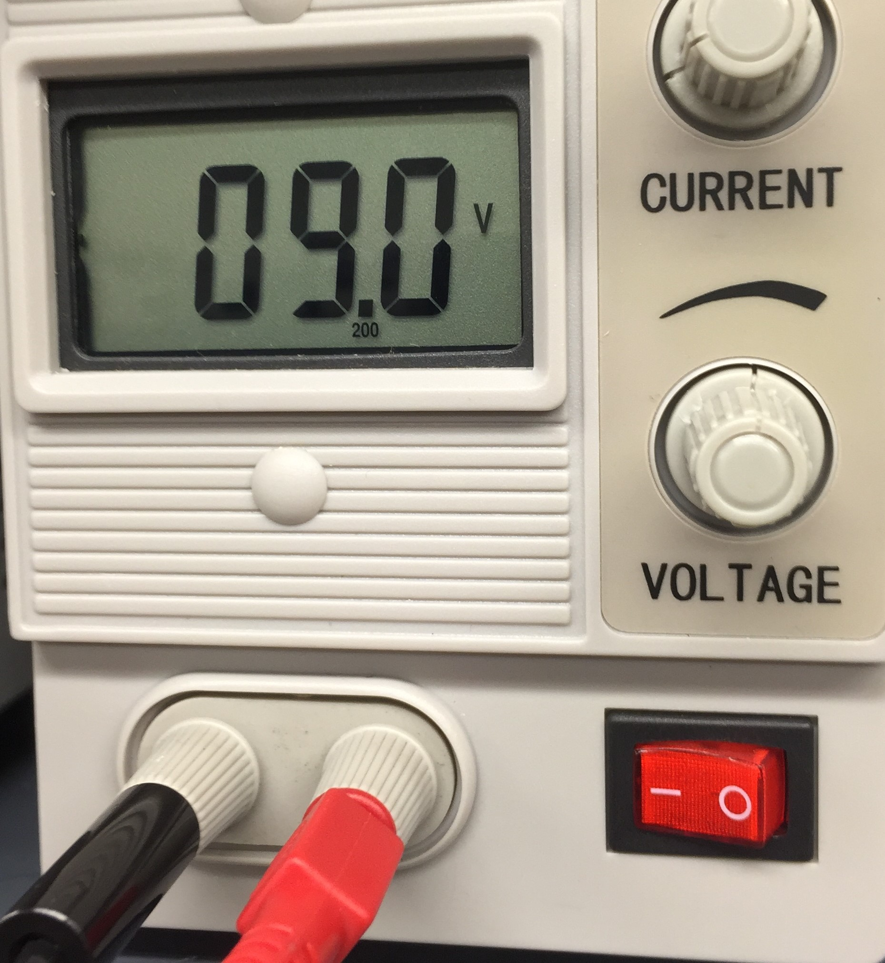
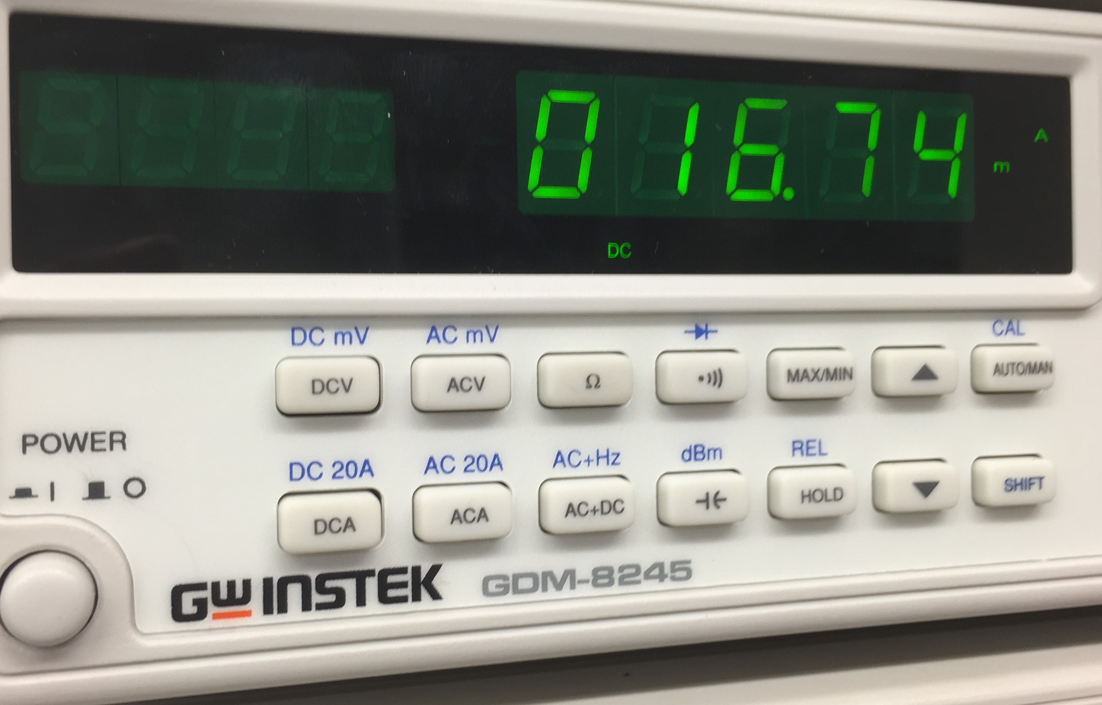
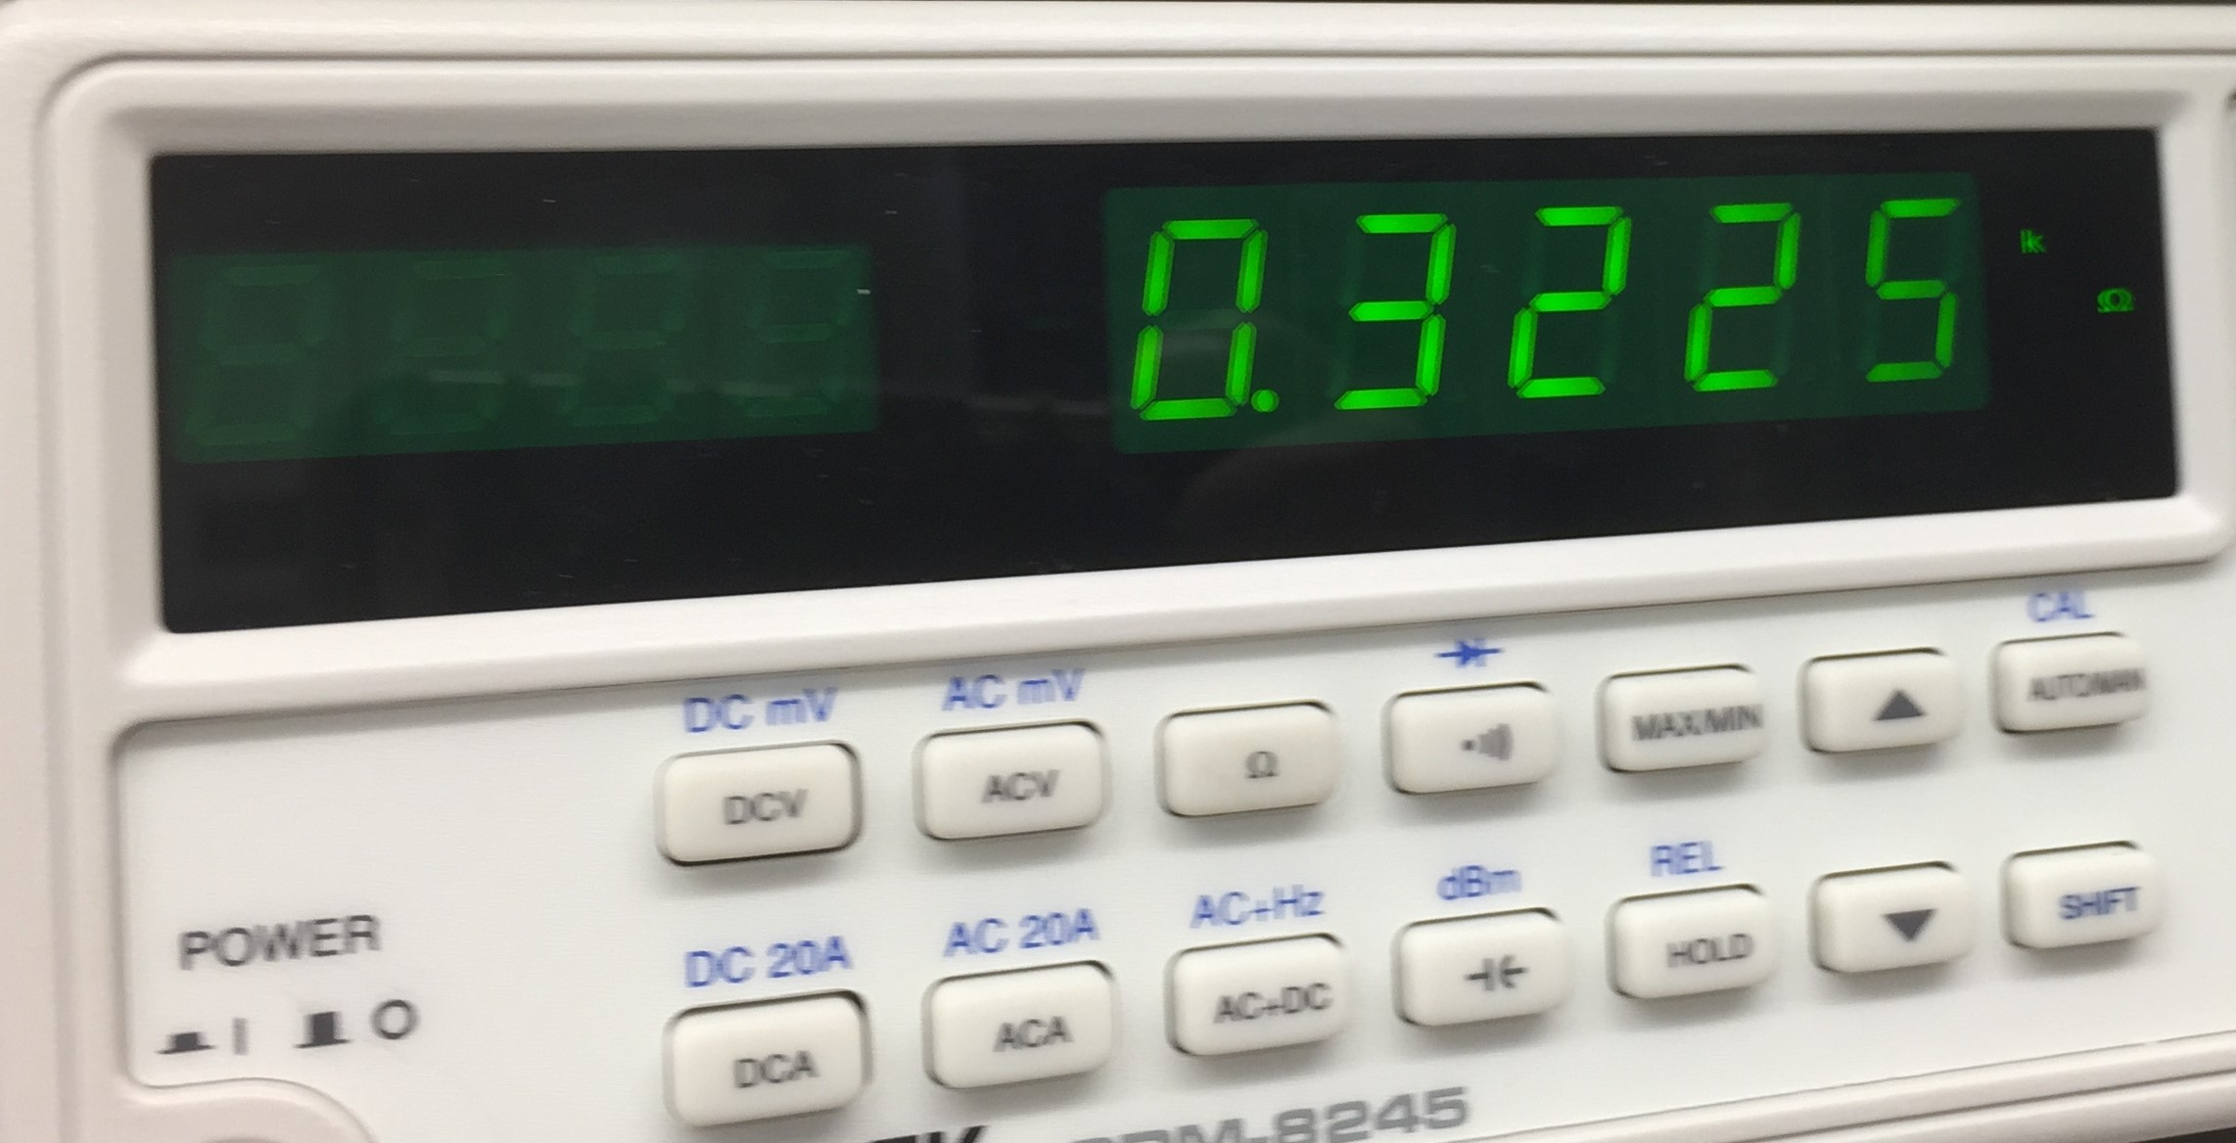
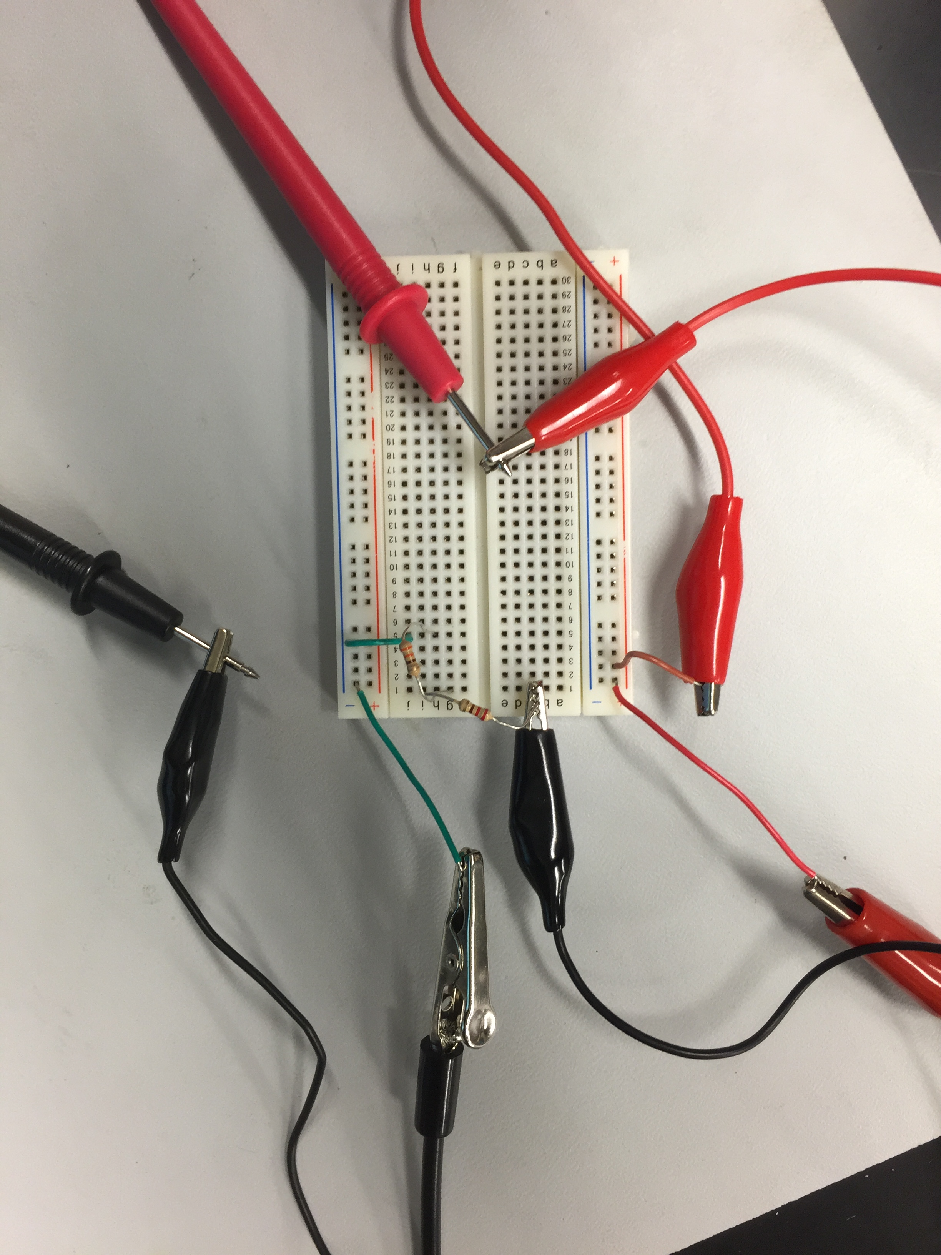
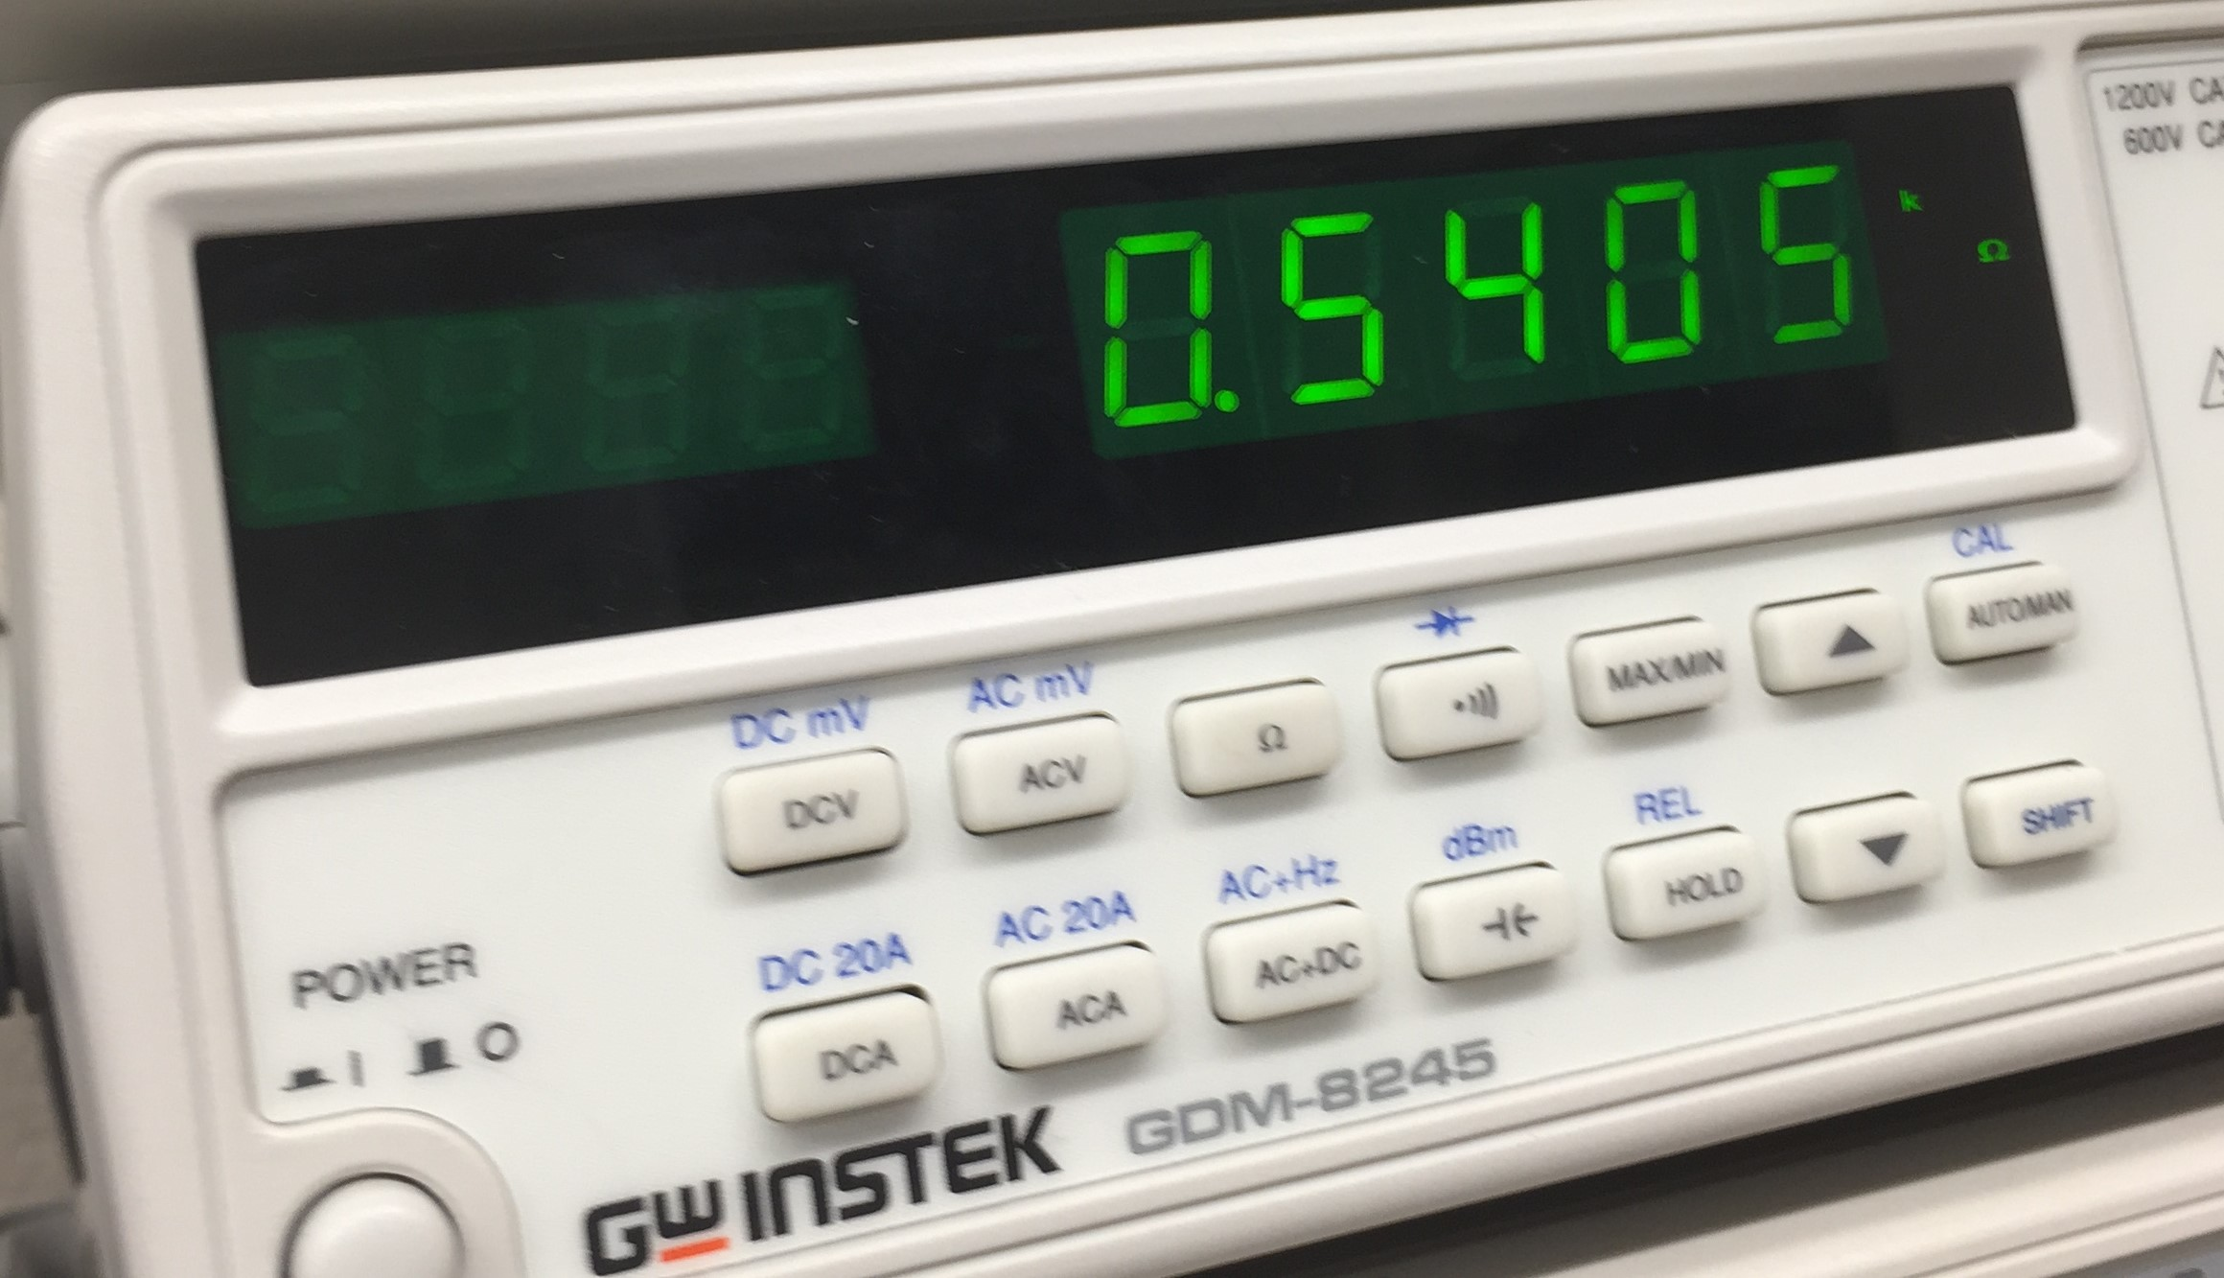
Lab # 06 – Black Box Design #3
Series Circuit
Measuring
R1
Vin
IT
R2
RT

Slide 29
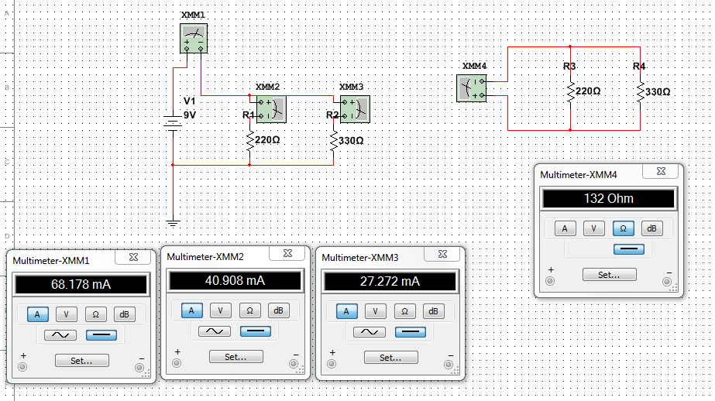
Lab # 06 – Black Box Design #3
Parallel Circuit
Data Recorded in Excel
Simulation in Multisim
 | Calculated | Measured | Simulated
V1 = | 9 | 9 | 9 | V
R1 = | 220 | 217.8 | 220 | Ω
R2 = | 330 | 322.5 | 330 | Ω
RT | 132 | 130.1 | 132 | Ω
I1 | 40.9E-3 | 41.7E-3 | 40.9E-3 | Amps
I2 | 27.3E-3 | 27.2E-3 | 27.3E-3 | Amps
IT | 68.2E-3 | 69.3E-3 | 68.2E-3 | Amps

Slide 30
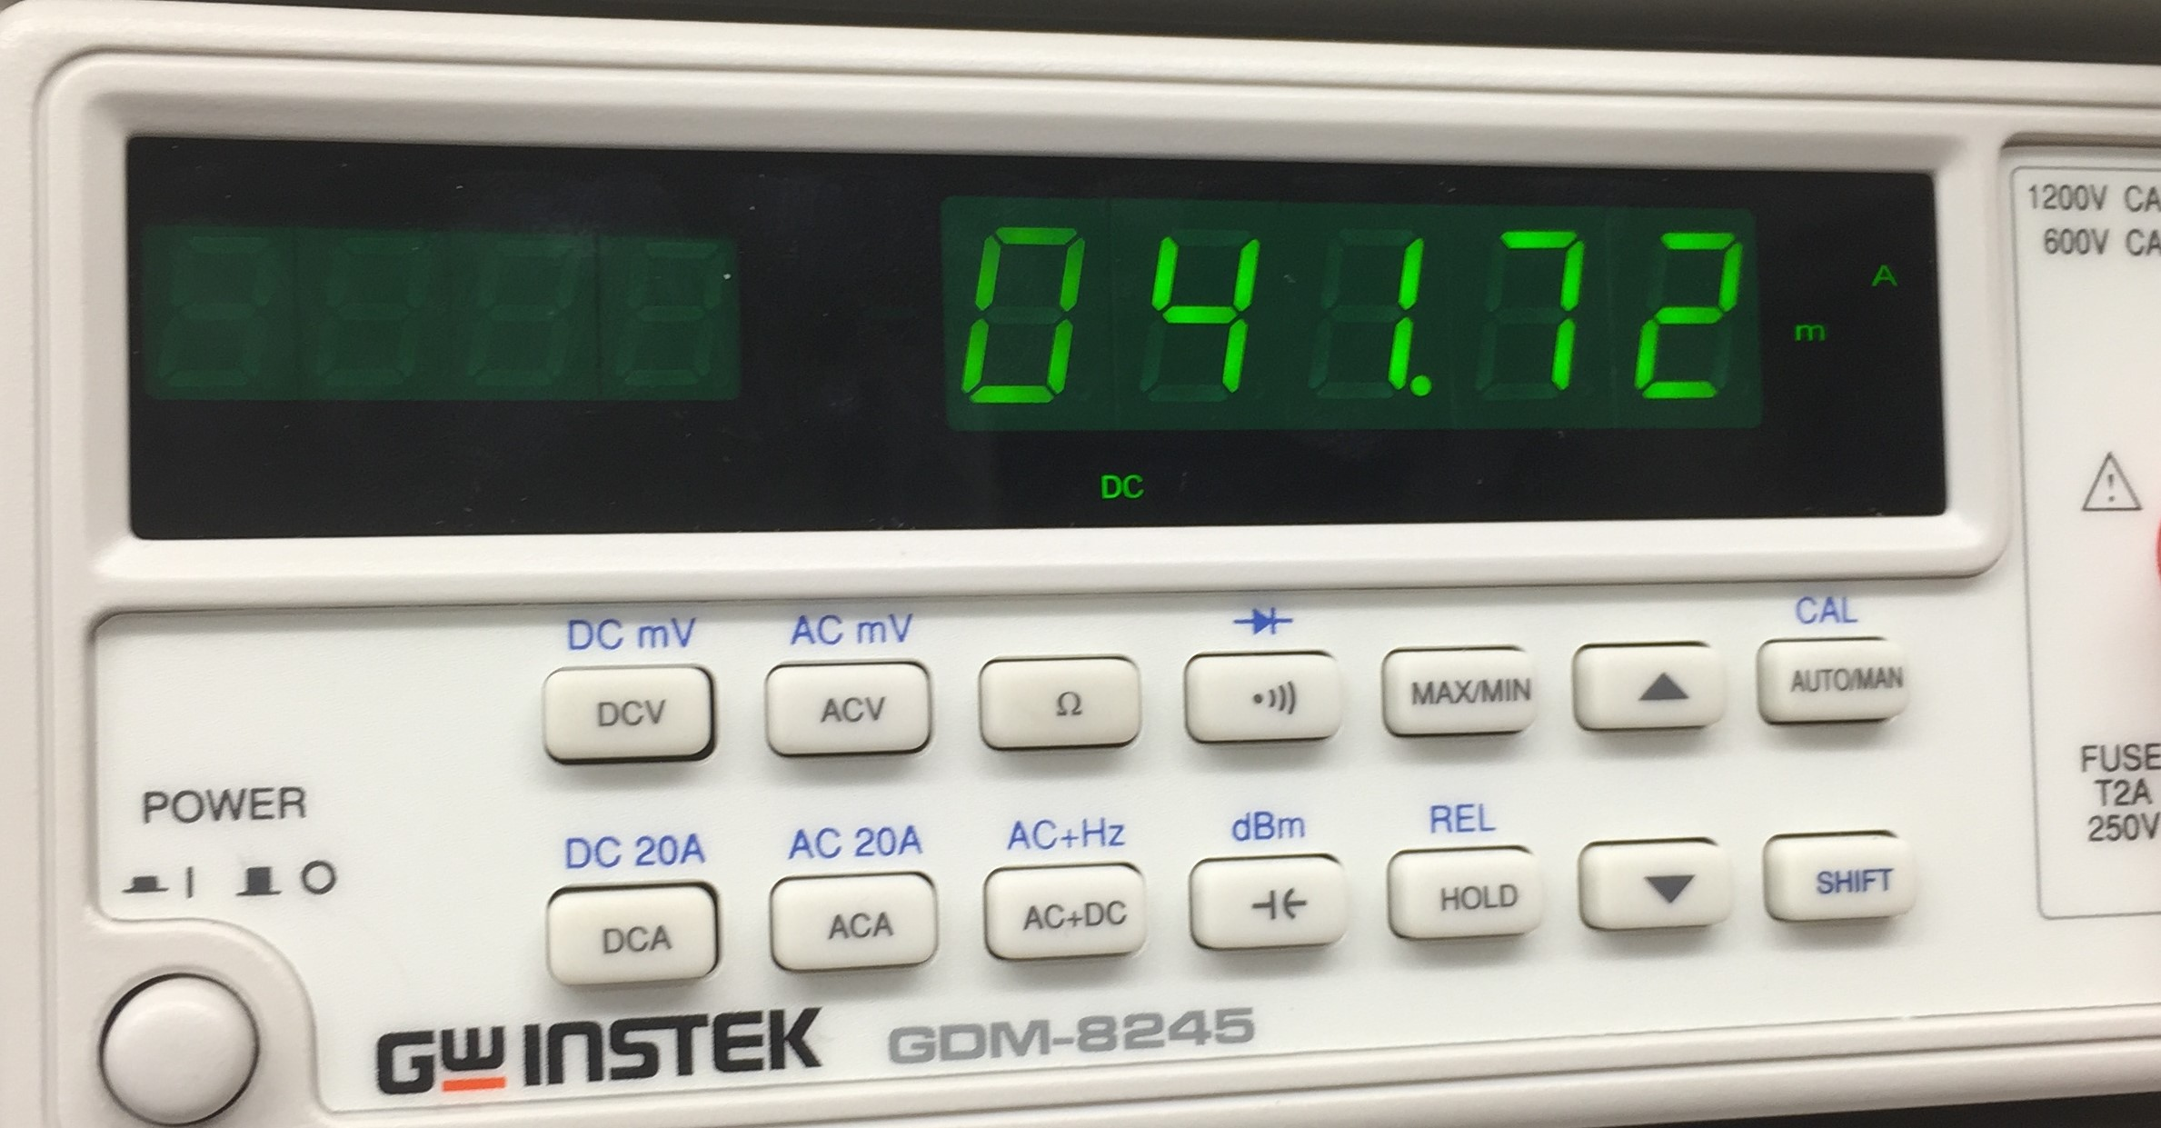
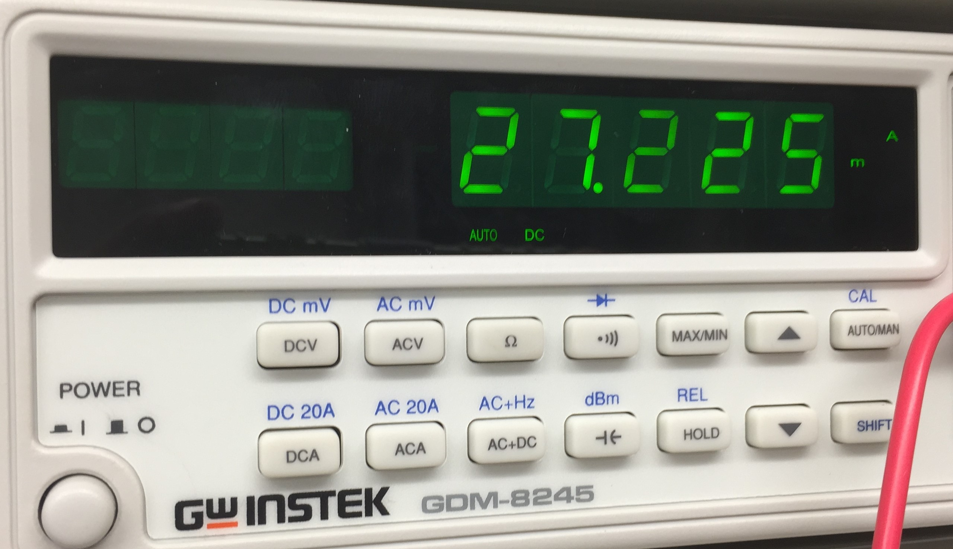
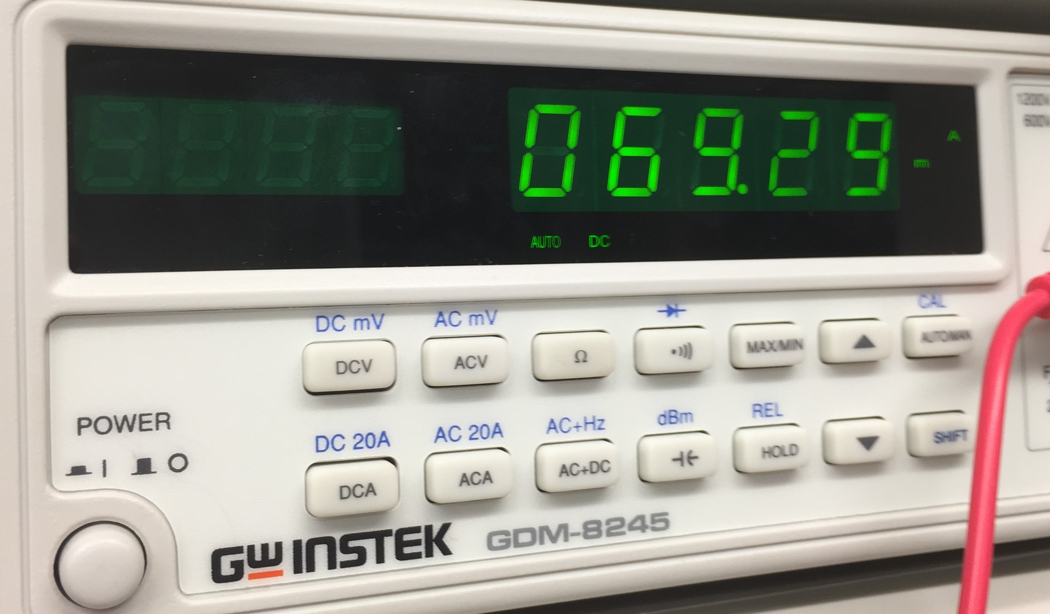
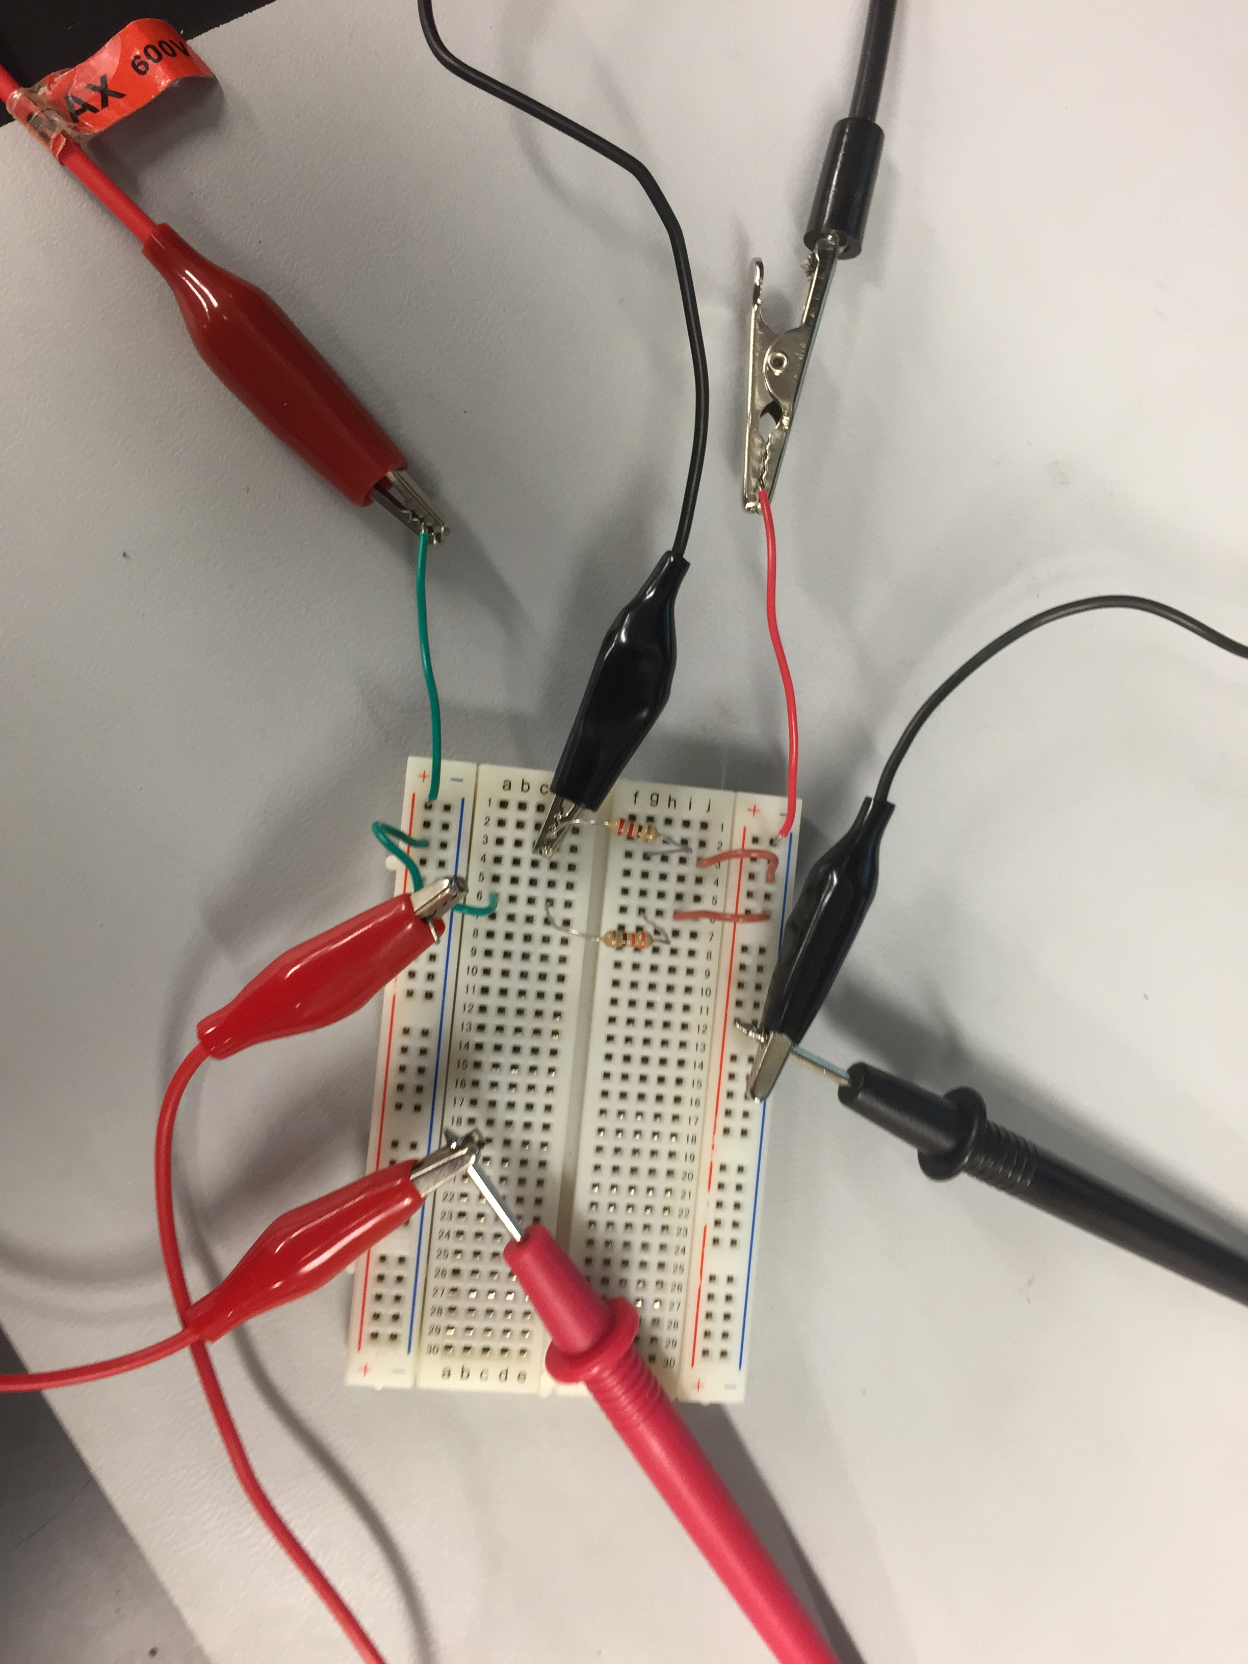
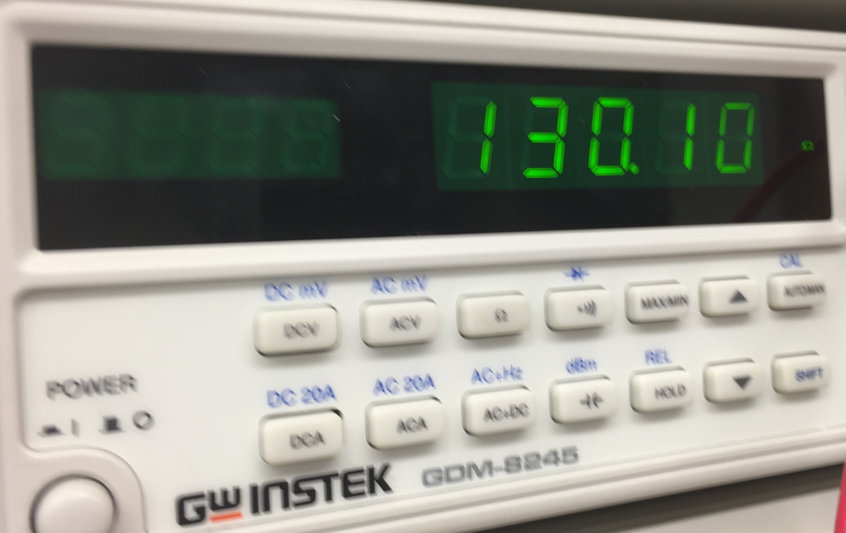
Lab # 06 – Black Box Design #3
Parallel Circuit
Measuring
R1
I1
Vin
I2
R2
IT
RT

Slide 31
Lab # 07 – 4 Resistor Parallel Circuit
Objective:
  Learn about parallel circuits. Design a 4 resistor parallel circuit with an applied voltage of 9V and measure all the resistor values, total current and all the branches current.
Theory:
  The simulation in multisim, analysis through calculation and test by measuring all have the same outcome.
Tools:
  4 resistors (2.2 KΩ, 3.3 KΩ, and 2 – 4.7 KΩ)
  Digital Multimeter: Bench 6: GDM-8245, Series: CL860332
  Excel
  Multisim

Slide 32
Lab # 07 – 4 Resistor Parallel Circuit
Procedure:
  Calculate:
    Find the total resistance of the parallel circuit
    Find the current of all the braches
    Find the total current
  Simulate:
    Build a parallel circuit in multisim of the 4 resistors. (2.2K, 3.3K, and 2 – 4.7K)
      Measure total resistance (RT)
      Measure the current in each branch (I1, I2, I3 and I4)
      Measure the total current (IT)
  Measure:
    Find the resistors by their color code. (2.2K Ω - R-R-R , 3.3K Ω - O-O-R, 4.7K Ω - Y-V-R)
    Measure and record the resistance of each resistor in excel.
    Connect the resistors in parallel.
    Measure and record the total resistance (RT)
    Add 9V to the parallel circuit.
    Measure and record the current at each branch (I1, I2, I3, and I4) and the total current (IT)

Slide 33
Lab # 07 – 4 Resistor Parallel Circuit
Calculations
 | Measured | Calculated | Simulated | Units
V1 = | 9.16 | 9 | 9 | V
RT = | 830 | 845.232 | 845.2 | Ω
I1 = | 4.21E-03 | 4.1E-3 | 4.09E-03 | Amps
I2 = | 2.79E-03 | 2.7E-3 | 2.70E-03 | Amps
I3 = | 1.97E-03 | 1.9E-3 | 1.91E-03 | Amps
I4 = | 1.96E-03 | 1.9E-3 | 1.91E-03 | Amps
IT = | 1.08E-02 | 10.6E-3 | 1.06E-02 | Amps
 | Design | Measured | Units
R1= | 2.2E+3 | 2.2E+3 | Ω
R2= | 3.3E+3 | 3.3E+3 | Ω
R3= | 4.7E+3 | 4.6E+3 | Ω
R4= | 4.7E+3 | 4.6E+3 | Ω

Slide 34
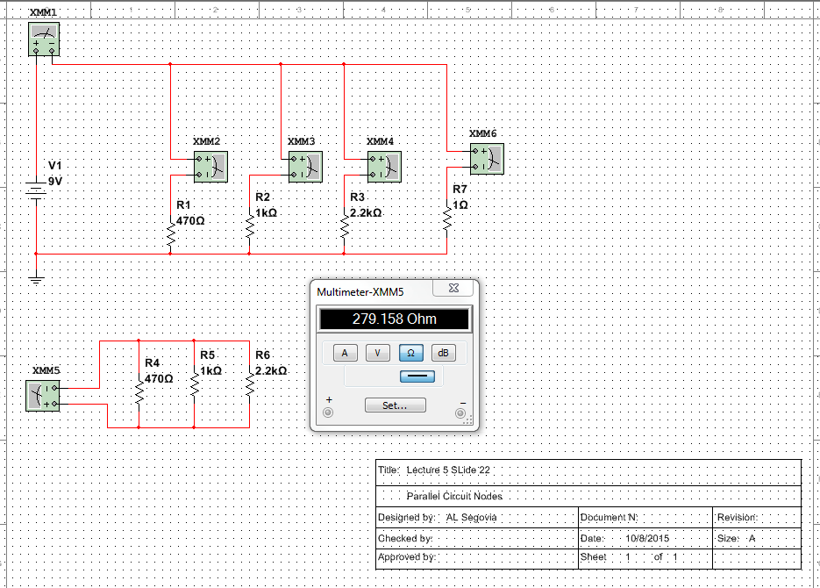
Lab # 07 – 4 Resistor Parallel Circuit
Simulation

Slide 35
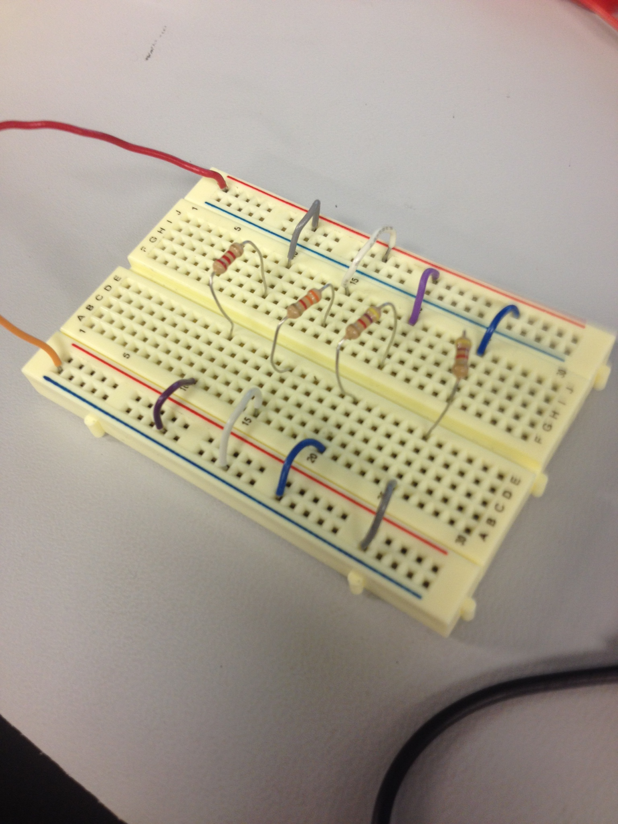
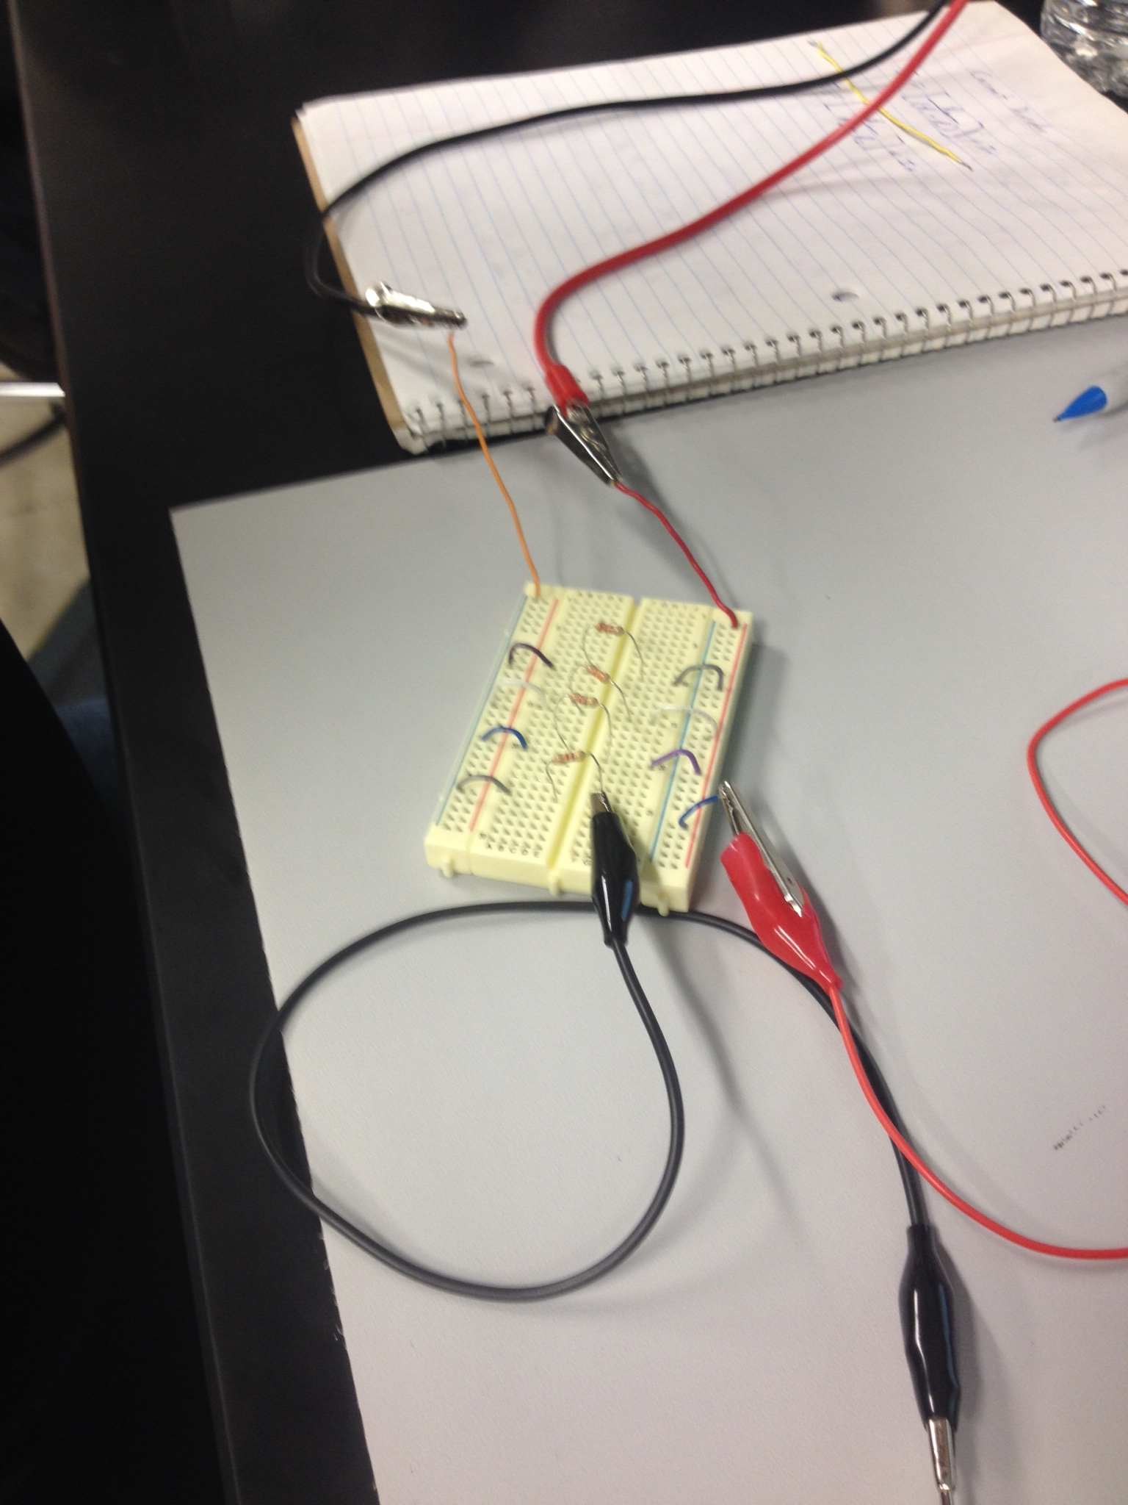
Lab # 07 – 4 Resistor Parallel Circuit
Measuring

Slide 36
Lab # 08 – Black Box 3 Design
Objective:
  Learn how to build a circuit that produces a certain voltage.
Theory:
  A 1.3V current can be produced by the circuit.
Tools:
  1 – 4.7 KΩ adjustable resistor.
  4 – 4.7 KΩ resistors
  Digital Multimeter: Bench 6: GDM-8245, Series: CL860332
  Excel
  Multisim

Slide 37
Lab # 08 – Black Box 3 Design
Procedure:
  Calculate:
    Find the total resistance needed to produce an output voltage of 1.3V.
    Subtract the two resistors already given to calculate the resistance inside the black box.
    Find what combination of equal value resistors, series or parallel, gives that resistance.
  Simulate:
    Based on the calculations build a circuit in multisim of the 5 - 4.7 kΩ resistors.
      Measure the output voltage with a Multimeter.
    Build a second circuit changing R1 to an adjustable resistor.
      Measure the output voltage with a Multimeter.

Slide 38
Lab # 08 – Black Box 3 Design
  Measure:
    Following the 1st mulisim schematic.
      Find the resistors by their color code. (4.7K Ω - Y-V-R)
      Measure and record the resistance of each resistor in excel.
      Connect the resistors in parallel.
      Measure and record the total resistance (RT) of the black box in excel.
      Add 9V to the parallel circuit.
      Measure the Vin, VA, VB and output voltage.
    Following the 2nd multisim schematic.
      Replace R1 with a variable resistor from the previous circuit.
      Add 9V to the parallel circuit.
      Measure the output voltage.
      Adjust the variable resistor to get an output of exactly 1.3V.
      Measure and record the resistance of the adjustable resistor in excel.

Slide 39
Lab # 08 – Black Box 3 Design
Calculations
Given
Vin | 9 | V
VA | 5.14 | V
VB | 3.86 | V
VA-VB | 1.28 | V
Rearrange the formula = VB = V * (R5 / RT) to find RT
 | Divide both sides by V = |  |  |  | VB/V = R5 / RT
 | (VB / V) are inverserly related to RT = |  |  |  | RT = R5 / (VB/V)
RT = | 11.0E+3 | Ω
R (Black Box) = RT -(R1+R5)
R(Black Box) = | 1.6E+3 | Ω
 | Design | Measured
R1 = | 4.7E+3 | 4.6E+3 | Ω
R2 = | 4.7E+3 | 4.6E+3 | Ω
R3 = | 4.7E+3 | 4.7E+3 | Ω
R4 = | 4.7E+3 | 4.6E+3 | Ω
R5 = | 4.7E+3 | 4.7E+3 | Ω
R(Black Box) = | 1.6E+3 | 1.5E+3 | Ω
R1adj = | 4.6E+3 | 4.5E+3 | Ω
RT | 11.0E+3 |  | Ω
 | Measured | Calculated | Simulated
V1 = | 9 | 9 | 9 | V
VA = | 5.178 | 5.143 | 5.14 | V
VB = | 3.892 | 3.857 | 3.86 | V
VA - VB = | 1.255 | 1.286 | 1.286 | V
(VA - VB) adj = | 1.302 | 1.3 | 1.302 | V

Slide 40
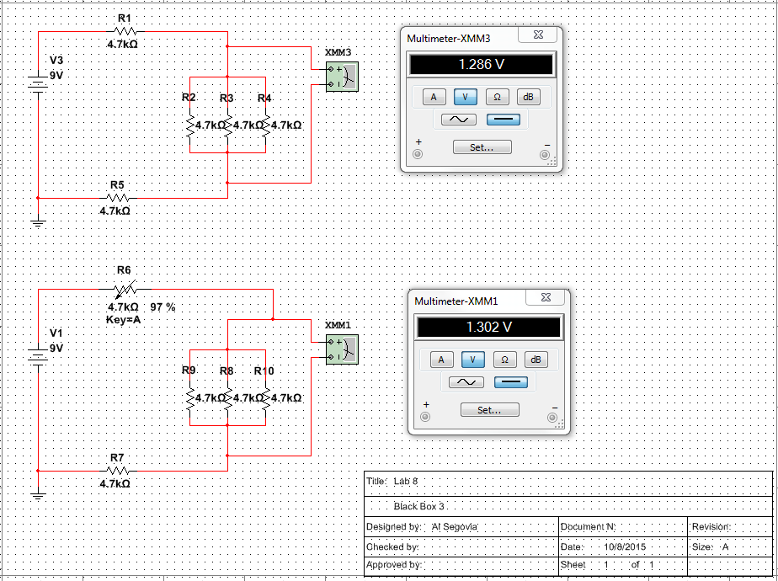
Lab # 08 – Black Box 3 Design
Simulation

Slide 41
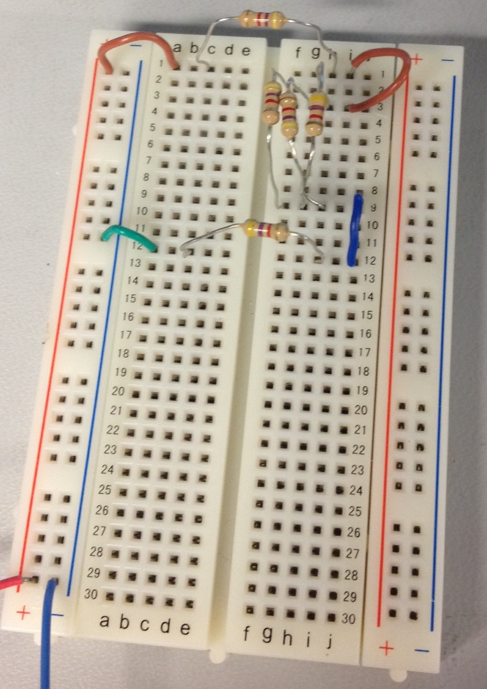
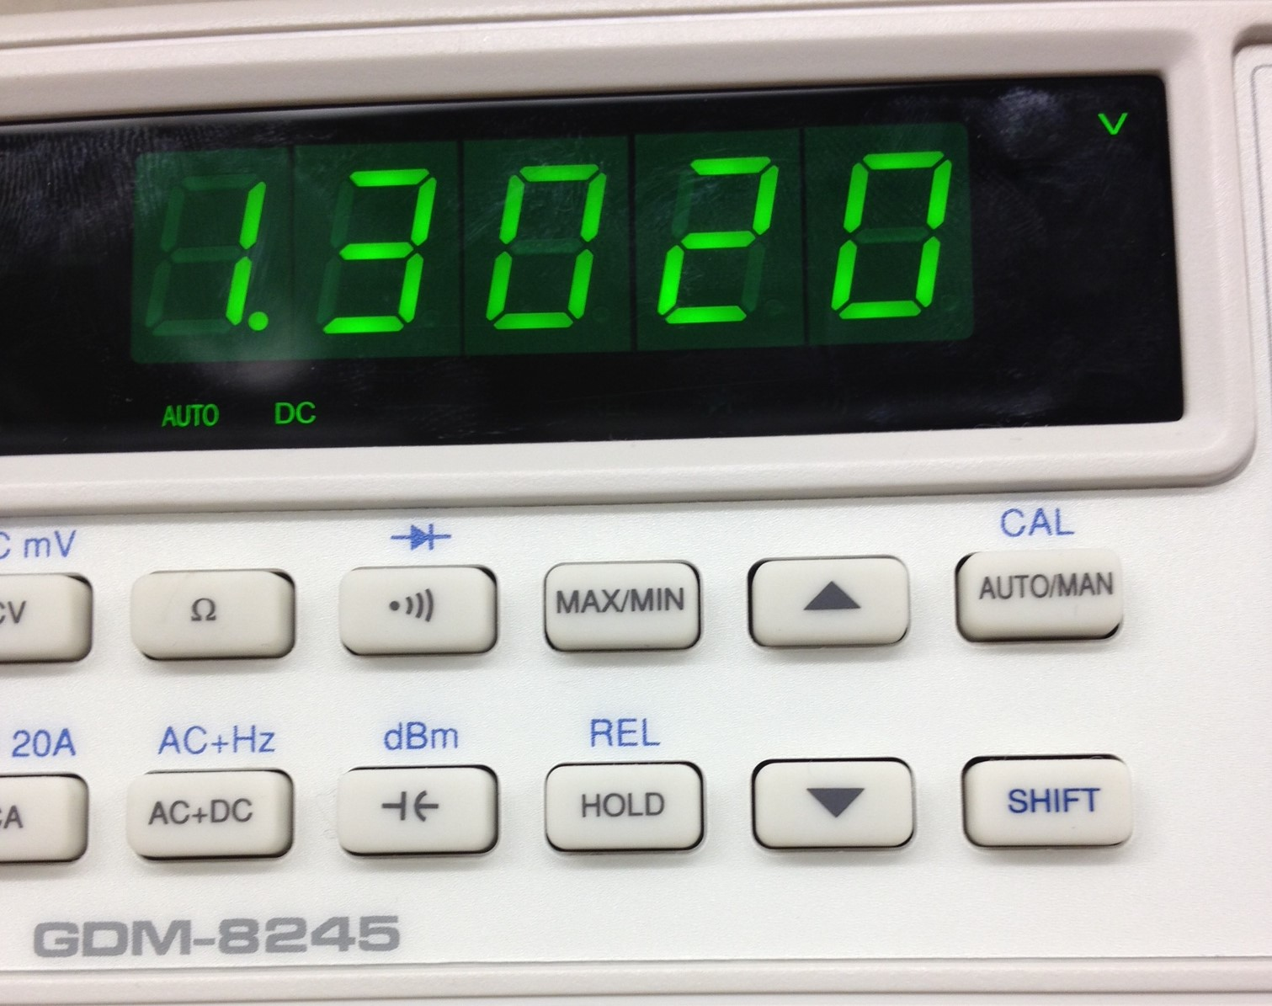
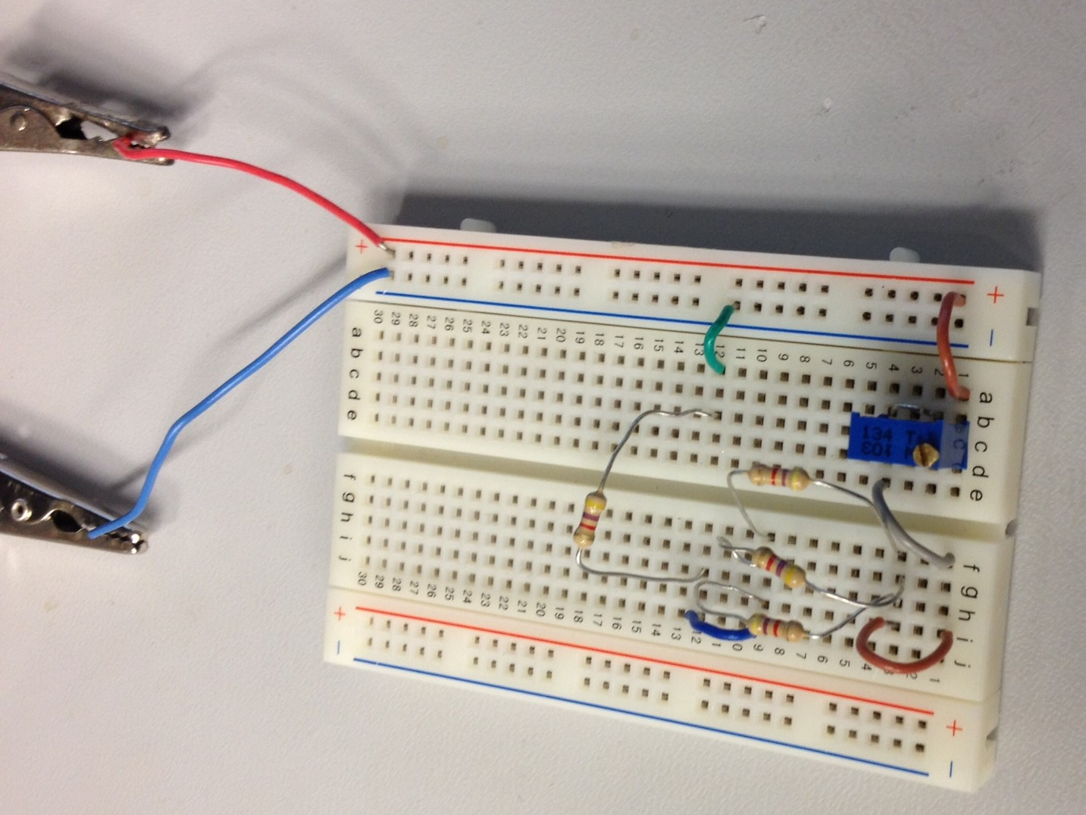
Lab # 08 – Black Box 3 Design
Measuring
All 4.7 kΩ resistors
Output Voltage
Vin
Adjustable resistor in R1

Slide 42
Lab # 09 – Series/parallel resistors
Objective:
  To experiment with series and verify that simulation, calculation, and test results all agree
Theory:
  That the simulation, calculation, and test results all agree.
Tools:
  8 resistors:
    2 – 470 Ω
    2 – 1k Ω
    1 – 2.2k Ω
    1 – 3.3k Ω
    1- 4.7k Ω
    1 – 10k Ω
  Digital Multimeter: Bench 6: GDM-8245, Series: CL860332
  Excel
  Multisim
  Breadboard

Slide 43
Lab # 09 – Series/parallel resistors
Procedure:
  Calculate:
    Calculate the resistance of the series/parallel groups in the circuit.
      R34 - Parallel
      R567 – Parallel
      R345678 – Series
      R2345678 – Parallel
      RT - Series
    Calculate the total current. (IT)
    Calculate the Voltage drops at VA, VB, and VC
    Adjust VA so that it equal to 4.5V and calculate the new resistor for R2

Slide 44
Lab # 09 – Series/parallel resistors
Procedure:
  Simulate:
    Build the series/parallel circuit shown in figure 1in multisim of the 8 resistors. (2-470Ω, 2-1kΩ , 1-2.2kΩ, 1-3.3kΩ, 1– 4.7kΩ, and 1-10kΩ)
      Measure the resistance as series/parallel groups as calculated.
      Measure the total resistance. (RT)
    Build the series/parallel circuit shown in figure2 adding 9 volts to the previous circuit in multisim.
      Measure the total current (IT)
      Measure the voltage drops at VA, VB, and VC.
  Measure:
    Following the 1st mulisim schematic.
      Find the resistors by their color code.
      Measure and record the resistance of each resistor in excel.
      Connect the resistors in series/parallel as shown in the schematic.
      Measure and record the total resistance (RT) in excel.
      Add 9V to the parallel circuit.
      Measure the Vin, IT, VA, VB, and VC.

Slide 45
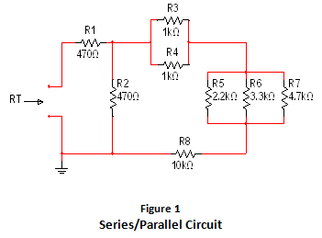
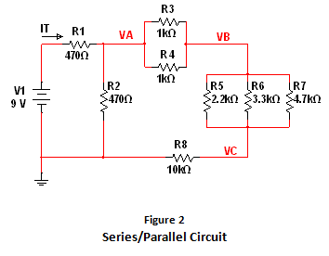
Lab # 09 – Series/parallel resistors

Slide 46
Lab # 09 – Series/parallel resistors
Calculations
Calculating Resistance
Calculating Nodal Voltage
 | Expected | Measured
R1 = | 470.00 | 455.20 | Ω
R2 = | 470.00 | 460.64 | Ω
R3 = | 1.0E+3 | 983.70 | Ω
R4 = | 1.0E+3 | 978.10 | Ω
R5 = | 2.2E+3 | 2.1E+3 | Ω
R6 = | 3.3E+3 | 3.2E+3 | Ω
R7 = | 4.7E+3 | 4.6E+3 | Ω
R8 = | 10.0E+3 | 9.8E+3 | Ω
 | Calculated | Simulated | Measured
R34 = | 500.00 | 500.00 | 491.13 | Ω
R567 = | 1.031E+3 | 1.031E+3 | 1.007E+3 | Ω
R345678 = | 11.531E+3 | 11.531E+3 | 11.242E+3 | Ω
R2345678 = | 451.59 | 451.59 | 460.80 | Ω
RT = | 921.59 | 921.59 | 917.00 | Ω
 | Calculated | Simulated | Measured
V1 = | 9.00 | 9.00 | 9.12 | V
IT = | 9.766E-3 | 9.770E-3 | 10.050E-3 | A
VA = | 4.41 | 4.41 | 4.37 | V
VB = | 4.22 | 4.22 | 4.18 | V
VC = | 3.82 | 3.82 | 3.79 | V
Calculating Nodal Voltage w/ adjustment
 | R2 Adjusted
 | Measured | Simulated | Calculated
VA = | 4.997 | 4.50 | 4.50 | V
R2 = | 443.23 | 490 | 489.97 | Ω

Slide 47
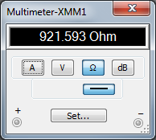
Lab # 09 – Series/parallel resistors
Simulation
Simulating Resistance

Slide 48
Lab # 09 – Series/parallel resistors
Simulation
Simulating Nodal Voltage
w/ adjustment
Simulating Nodal Voltage

Slide 49
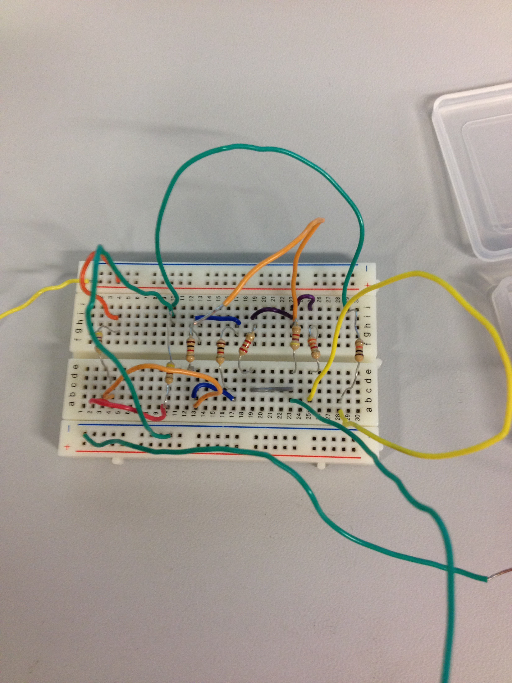
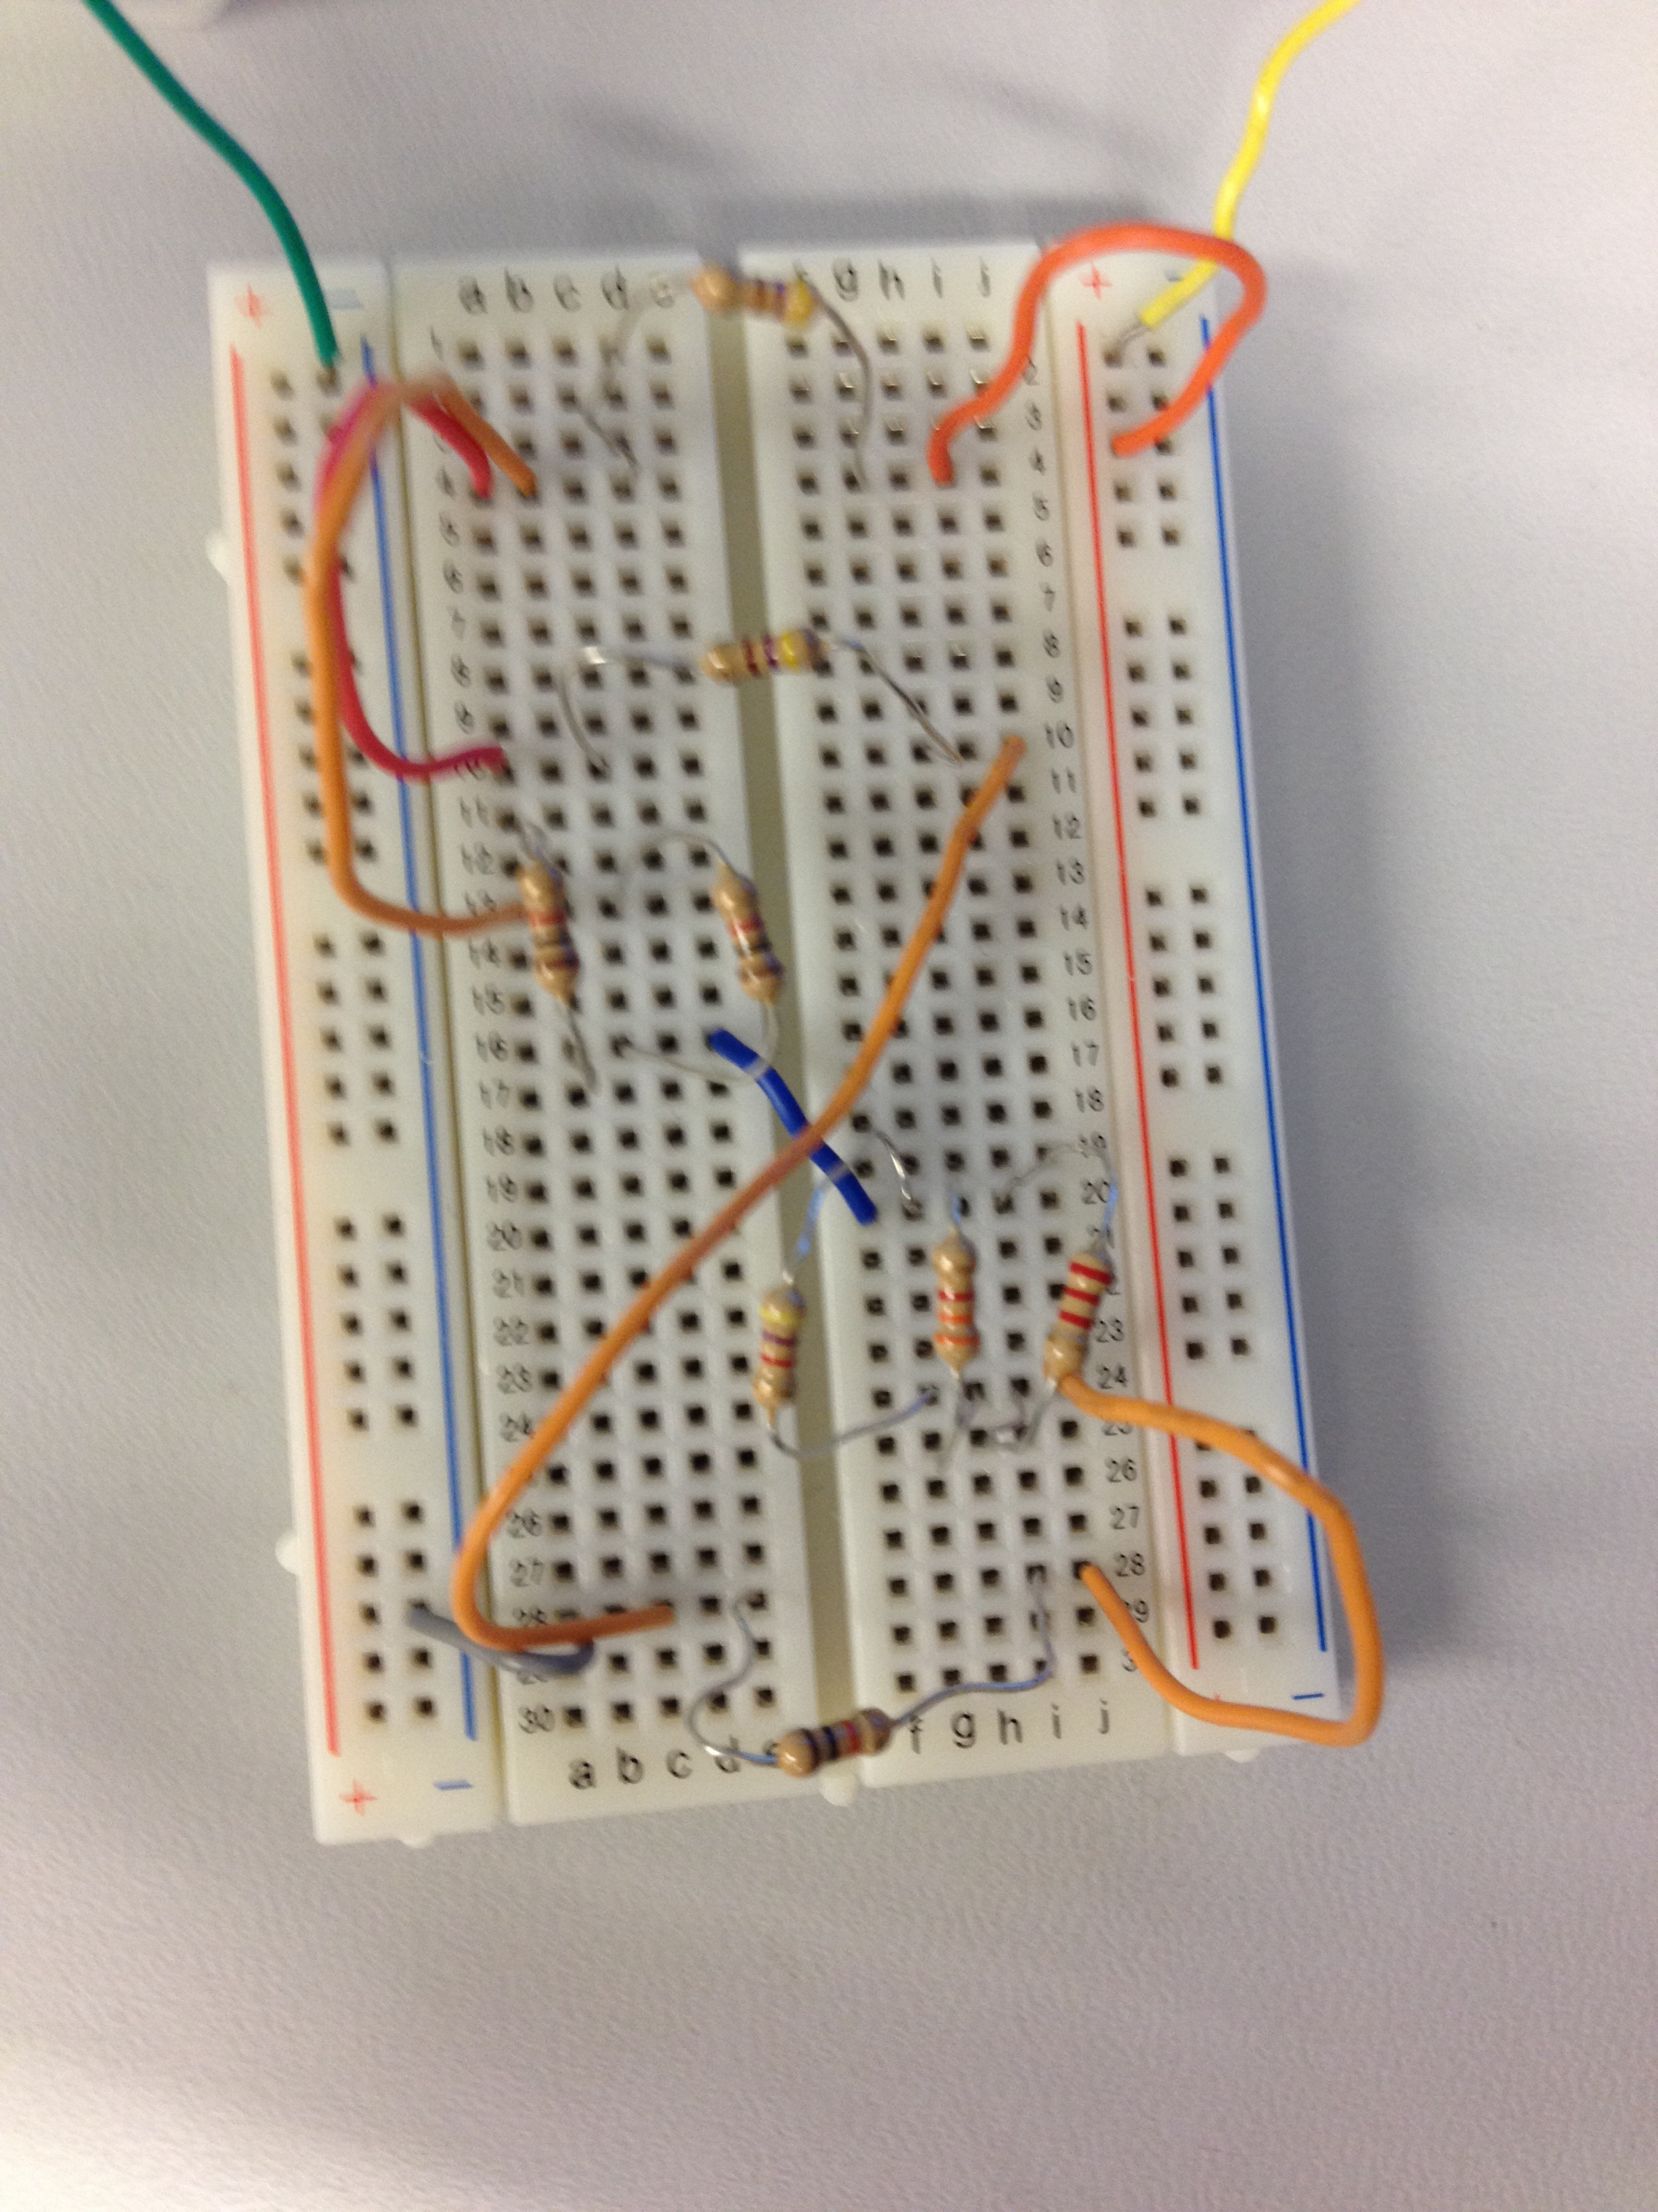
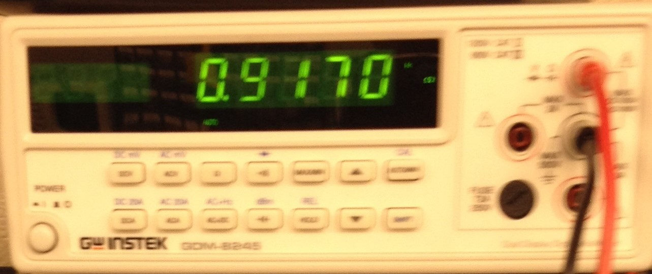
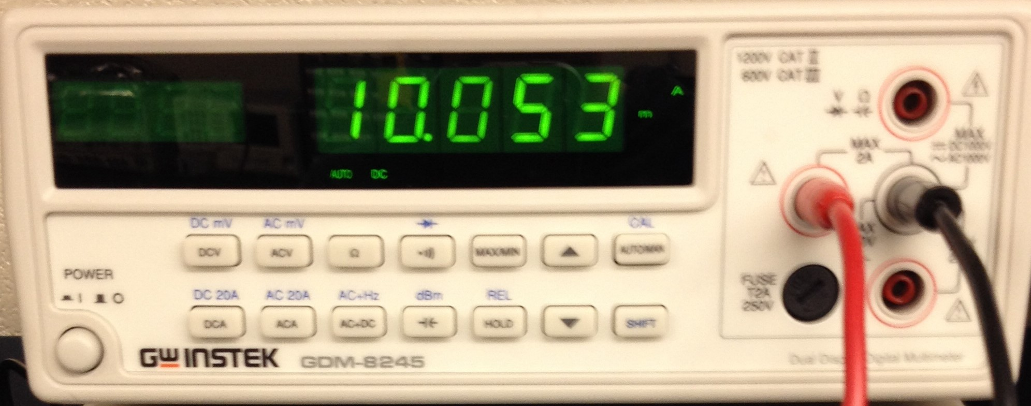
Lab # 09 – Series/parallel resistors
Measuring
RT
IT

Slide 50
Lab # 10 – Series/parallel Capacitors
Objective:
  To experiment with series and parallel combinations of capacitors.
Theory:
  That the calculation and test agree with each other.
Tools:
  3 capacitors:
    1 - 10µF
    1 - 22µF
    1 - 47µF
  LCR Meter (Bench 2: LCR-819, E120999)
  Excel
  Multisim
  Breadboard

Slide 51
Lab # 10 – Series/parallel Capacitors
Procedure:
  Calculate:
    Calculate the total capacitance of the series circuit in figure 1.
    Calculate the total capacitance of the parallel circuit in figure 2.
  Measure:
    Find the 3 capacitors: C1: 10µF, C2: 22µF, C3: 47µF
      Measure each capacitor and record data in excel.
    Connect the capacitors in series as shown in figure 1.
      Measure and record the total capacitance. (CT)
    Connect the capacitors in parallel as shown in figure 2.
      Measure and record the total capacitance. (CT)

Slide 52
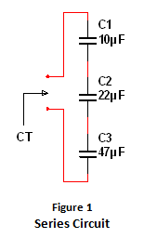
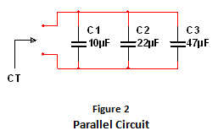
Lab # 10 – Series/parallel Capacitors
Calculations
 | Series
 | Expected | Measured
C1 = | 10.0E-6 | 9.6E-6 | F
C2 = | 22.0E-6 | 20.5E-6 | F
C3 = | 47.0E-6 | 37.463e-6 | F
CT = | 6.0E-6 | 5.2E-6 | F
 | Parallel
 | Expected | Measured
C1 = | 10.0E-6 | 9.6E-6 | F
C2 = | 22.0E-6 | 20.5E-6 | F
C3 = | 47.0E-6 | 37.463E-6 | F
CT = | 79.0E-6 | 79.5E-6 | F

Slide 53



Lab # 10 – Series/parallel Capacitors
Simulation

Slide 54




Lab # 10 – Series/parallel Capacitors
Measuring
Series
Parallel

Slide 55
Lab # 11 – RC Lab
Objective:
  To experiment with RC (resistors & capacitor) circuit.
Theory:
  That the simulation and test agree with each other.
Tools:
  1 – resistor: 1kΩ
  3 capacitors:
    1 - .47µF
    1 - 1µF
    1 – 2.2µF
  LCR Meter (Bench 2: LCR-819, E120999)
  DMM
  Oscilloscope
  Function Generator
  Excel
  Multisim
  Breadboard

Slide 56
Lab # 11 – RC Lab
Procedure:
  Simulation:
    Build the RC circuit in multisim as shown in figure 1 with a Vin of 5.76Vpk.
    Using an oscilloscope
      Measure the expected output voltage for the different frequencies and record date in excel.
    Change the capacitor.
    Measure using an oscilloscope.
      Measure the expected output voltage for the different frequencies and record date in excel.
  Measure:
    Find the color code for a 1k Ω resistor. (Br-Bl-R)
      Measure the resistor and record data in excel.
    Find the 3 capacitors: C1: 0.47µF, C2: 1µF, C3: 2.2µF
      Measure each capacitor and record data in excel.
    Connect the resistor and 1st capacitors as shown in figure 1.

Slide 57


Lab # 11 – RC Lab
Simulation vs Measuring
 | Capacitance or Resistance
 | Expected | Measured
C1 = | 470.0E-9 | 1.0E-6 | F
C2 = | 1.0E-6 | 2.1E-6 | F
C3 = | 2.2E-6 | 473.0E-9 | F
R1 = | 1.0E+3 | 973.0E+0 | Ω

Slide 58



Lab # 11 – RC Lab
Simulation vs Measuring

Slide 59
Lab # 11 – RC Lab
Simulation vs Measuring
 | Output Voltage C = _0.47µF_ |  |  | Output Voltage C = __1µF_ |  |  | Output Voltage C = __2.2µF__
 | Expected | Measured |  | Expected | Measured |  | Expected | Measured
Frequency | Output Voltage | Input Voltage | Output Voltage | Output Voltage | Input Voltage | Output Voltage | Output Voltage | Input Voltage | Output Voltage
10 | 5.632 | 5.840 | 4.640 | 5.73 | 5.84 | 4.64 | 5.616 | 5.76 | 4.6
50 | 5.536 | 5.640 | 5.440 | 5.401 | 5.8 | 5.36 | 4.695 | 5.76 | 4.64
100 | 5.325 | 5.840 | 5.520 | 4.8 | 5.76 | 4.72 | 3.305 | 5.64 | 3.28
200 | 4.798 | 5.840 | 4.960 | 3.475 | 5.68 | 3.48 | 1.912 | 5.6 | 1.96
300 | 4.153 | 5.840 | 4.280 | 2.64 | 5.6 | 2.6 | 1.323 | 5.6 | 1.36
400 | 3.546 | 5.840 | 3.680 | 2.042 | 5.6 | 2.08 | 1.006 | 5.56 | 1.02
500 | 3.106 | 5.680 | 3.200 | 1.682 | 5.6 | 1.72 | 0.812 | 5.56 | 0.832
600 | 2.697 | 5.680 | 2.760 | 1.422 | 5.56 | 1.44 | 0.679 | 5.56 | 0.704
700 | 2.341 | 5.680 | 2.440 | 1.24 | 5.56 | 1.28 | 0.584 | 5.56 | 0.608
800 | 2.119 | 5.680 | 2.200 | 1.085 | 5.56 | 1.12 | 0.51 | 5.56 | 0.528
900 | 1.920 | 5.680 | 1.960 | 0.963 | 5.56 | 1.02 | 0.453 | 5.56 | 0.48
1,000 | 1.753 | 5.680 | 1.800 | 0.872 | 5.56 | 0.9 | 0.408 | 5.56 | 0.428
2,000 | 0.919 | 5.680 | 1.000 | 0.437 | 5.72 | 0.52 | 0.205 | 5.72 | 0.228
3,000 | 0.624 | 5.840 | 0.648 | 0.298 | 5.72 | 0.316 | 0.134 | 5.68 | 0.156
4,000 | 0.467 | 5.760 | 0.488 | 0.223 | 5.72 | 0.234 | 0.102 | 5.64 | 0.122
5,000 | 0.366 | 5.840 | 0.392 | 0.178 | 5.68 | 0.192 | 0.081 | 5.68 | 0.096
6,000 | 0.309 | 5.840 | 0.328 | 0.148 | 5.68 | 0.16 | 0.068 | 5.64 | 0.082
7,000 | 0.263 | 5.840 | 0.284 | 0.127 | 5.64 | 0.14 | 0.058 | 5.64 | 0.072
8,000 | 0.233 | 5.760 | 0.244 | 0.111 | 5.64 | 0.121 | 0.051 | 5.64 | 0.064
9,000 | 0.206 | 5.760 | 0.220 | 0.099 | 5.64 | 0.107 | 0.0446 | 5.64 | 0.056
10,000 | 0.187 | 5.680 | 0.196 | 0.0892 | 5.56 | 0.0968 | 0.0408 | 5.56 | 0.0512

Slide 60
Lab # 12 – Series/Parallel Inductors
Objective:
  To experiment with series and parallel combinations of inductors.
Theory:
  That the calculation, simulation and test agree with each other.
Tools:
  3 Inductors:
    1 – 1mH
    1 – 2.2mH
    1 – 4.7mH
  LCR Meter (Bench 2: LCR-819, E120999)
  Excel
  Multisim
  Breadboard

Slide 61
Lab # 12 – Series/Parallel Inductors
Procedure:
  Simulation:
    Build the series combination of inductors in multisim as shown in figure 1.
      Add 1mΩ resistor between the source and the inductor so that multisim can measure.
      Add a probe after the resistor.
    Measure by simulating a single frequency AC analysis.
      60Hz
      Output: using the probe to select the variable for analysis.
        Formula: V(Probe1)/(2*PI*60*I(Probe1))
    Build the series combination of inductors in multisim as shown in figure 2.
      Add a 1mΩ resistor between each inductor so that multisim can measure.
      Add a probe before the 1st resistor.
    Measure by simulating a single frequency AC analysis.
      60Hz
      Output: using the probe to select the variable for analysis.
        Formula: V(Probe1)/(2*PI*60*I(Probe1))

Slide 62
Lab # 12 – Series/Parallel Inductors
Procedure:
  Measure:
    Find the 3 Inductors: L1: 1mH, L2: 2.2mH, L3: 4.7mH
        Measure each inductor and record data in excel.
    Series Inductor Circuit
      Connect the inductors in series as shown in figure 1.
      Measure total inductance of the series circuit.
    Parallel Inductor Circuit
      Connect the inductors in series as shown in figure 2.
      Measure total inductance of the series circuit.

Slide 63


Lab # 12 – Series/Parallel Inductors
Calculations
Series
 | Expected | Simulated | Measured
L1 = | 1.0E-3 | 1.0E-3 | 985.7E-6 | H
L2 = | 2.2E-3 | 2.2E-3 | 2.3E-3 | H
L3 = | 4.7E-3 | 4.7E-3 | 4.4E-3 | H
LT = | 7.9E-3 | 7.9E-3 | 7.4E-3 | H
Parallel
 | Expected | Simulated | Measured
L1 = | 1.0E-3 | 1.0E-3 | 985.7E-6 | H
L2 = | 2.2E-3 | 2.2E-3 | 2.3E-3 | H
L3 = | 4.7E-3 | 4.7E-3 | 4.4E-3 | H
LT = | 599.8E-6 | 599.8E-6 | 607.0E-6 | H

Slide 64

Lab # 12 – Series/Parallel Inductors
Simulation - Series

Slide 65

Lab # 12 – Series/Parallel Inductors
Simulation - Parallel

Slide 66



Lab # 12 – Series/Parallel Inductors
Measuring
Series
Parallel
Parallel

Slide 67
Lab # 13 – RL Lab
Objective:
  To experiment with RL (Resistor & Inductor) circuit.
Theory:
  That the simulation and Measuring agree with each other.
Tools:
  3 Inductors:
    1 – 1mH
    1 – 2.2mH
    1 – 4.7mH
  LCR Meter (Bench 2: LCR-819, E120999)
  DMM
  Oscilloscope
  Function Generator
  Excel
  Multisim
  Breadboard

Slide 68
Lab # 13 – RL Lab
Procedure:
  Simulation:
    Build the RL circuit in multisim as shown in figure 1 with a Vin of 1Vpk.
    Measure by simulating an AC analysis.
      Frequency parameters:
        FSTART: 10 Hz
        FSTOP: 100 kHz
        Sweep type (Decade)
      Output: using the probe to select the variable for analysis.
        Formula: V(vout)/V(vin)
    Export data to Excel

Slide 69
Lab # 13 – RL Lab
Procedure:
  Measure:
    Find the color code for a 1k Ω resistor. (Br-Bl-R)
      Measure the resistor and record data in excel.
    Find the 3 capacitors: C1: 0.47µF, C2: 1µF, C3: 2.2µF
      Measure each capacitor and record data in excel.
    Connect the resistor and 1st capacitors as shown in figure 1.
    Using the Frequencies of the exported data in the simulation.
      Measure the output voltage at those frequencies.

Slide 70




Lab # 13 – RL Lab
Simulation
VOUT1/VIN1
VOUT2/VIN2
VOUT3/VIN3

Slide 71






Lab # 13 – RL Lab
Measuring

